Slide 1
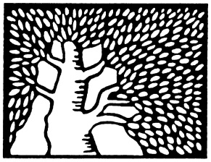
On the Degree of Univariate Polynomials Over the Integers
Gil Cohen
Weizmann Institute
Joint work with
Amir Shpilka and Avishay Tal

Slide 2
The Question

Slide 3
The Question
What is the minimal degree of
a polynomial of the form
$f:\left\{0,1,…,n\right\}→\left\{0,1,…,m\right\}$?
$$2$$
$$1$$
Mmm… 0
$$0$$
$$0$$
$$1$$
$$2$$
$$3$$
$$4$$
$$5$$
$$6$$
$$7$$

Slide 4
The Question
What is the minimal degree of
a non-constant polynomial of the form
$f:\left\{0,1,…,n\right\}→\left\{0,1,…,m\right\}$?
$$2$$
$$1$$
Mmm…
$$0$$
$$0$$
$$1$$
$$2$$
$$3$$
$$4$$
$$5$$
$$6$$
$$7$$

Slide 5
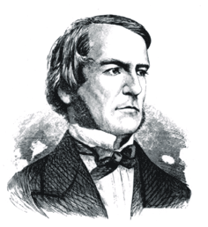
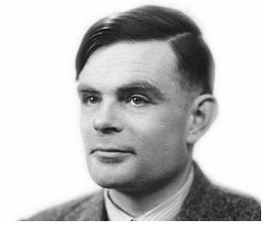
What is it
to Us?
George Boole
Alan Turing

Slide 6
Original Motivation
The degree of a (Boolean multivariate) polynomial is a natural complexity measure for the function it represents [MP68, NS91, Pat92, GR97]
Related to other complexity measures.
[NS91] Gave a tight $Ω\left(log\left(n\right)\right)$ lower bound on the degree of a polynomial of the form
$f:{\left\{0,1\right\}}^{n}→\left\{0,1\right\}$ (assuming dependency in all variables).

Slide 7
Original Motivation
[GR97] proved an $n−Γ\left(n\right)$ lower bound for symmetric Boolean multivariate polynomials.
Can be thought of as univariate polynomials of the form $f:\left\{0,1,…,n\right\}→\left\{0,1\right\}$.
[GR97] asked what could be said when the range is $\left\{0,1,…,m\right\}$?
$$Γ\left(n\right)=O\left(n^{0.525}\right)$$

Slide 8
Later Motivation
[ST11] Improved lower bounds on the minimal degree of polynomials $f:\left\{0,…,n\right\}→\left\{0,1,2\right\}$ implies better algorithms for learning symmetric (Boolean!) juntas.
In general, formal derivatives increase the range, and at this point good lower bounds might be useful.
$$f_{y}\left(x\right)=f\left(x+y\right)−f\left(x\right)$$

Slide 9
Observations
Minimal degree $≤n$.
When $m=n$, the minimal degree is $1$
(e.g., $f\left(x\right)=x$).
[GR97] For $m=1$, minimal degree $≥n−Γ\left(n\right)$.
By the pigeonhole principle, the minimal degree $≥\left\lceil \left(n+1\right)/\left(m+1\right)\right\rceil$.

Slide 10
Observations
What is the Real Behavior?
minimal degree
[GR97]
$$n$$
$$n−n^{.525}$$
$$n/3$$
$$\left\lceil \frac{n+1}{m+1}\right\rceil$$
$$f\left(x\right)=x$$
$$2$$
$$1$$
$$m$$
$$1$$
$$2$$
$n$/2
$$n−1$$
$$n$$

Slide 11
Main Result I
Theorem I. $∀m<n$ the minimal degree is at least $n−O\left(\frac{n}{\log{\log{n}}}\right)$.

Slide 12
Main Result I
minimal degree
$$n$$
$$n−n^{.525}$$
$$n−\frac{n}{\log{\log{n}}}$$
Threshold
$$n/3$$
$$2$$
$$1$$
$$m$$
$$1$$
$$2$$
$n$/2
$$n−1$$
$$n$$

Slide 13
Main Result II
minimal
degree
$$n$$
$$n−\frac{n}{\log{\log{n}}}$$
Hey, I’m over here!
?
$$1$$
$$m$$
$$1$$
$$n−1$$
$$n$$

Slide 14
Main Result II ($m>n$)
Theorem II. $∀m<{\left(\frac{n}{10d}\right)}^{d}$
$deg\left(f\right)≥\frac{n}{3}−O\left(\log{m}\right)$ or $deg\left(f\right)<d$
Probably an artifact of the proof
I’m listening..
Oh, fine by me!
A dichotomous behavior - no intermediate degree.
Holds $∀d<n/10$.

Slide 15
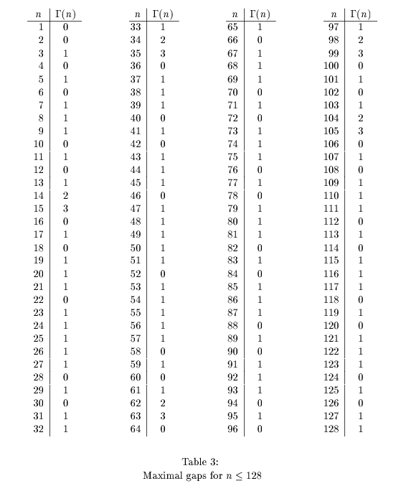
Upper Bounds
[GR97] Asked for upper bounds on the minimal degree of a non-constant polynomial
$f:\left\{0,1,…,n\right\}→\left\{0,1\right\}$ ?
Best they constructed: degree $n−3$.
Program search gave $3$ as well.

Slide 16
Main Result III (Upper Bounds)
Theorem III. For $m=O\left(2^{k}\right)$ there exists an $f:\left\{0,…,n\right\}→\left\{0,…,m\right\}$ s.t.
$$2k<deg\left(f\right)≤n−k$$
Hence, by Theorem II
$$\frac{n}{3}−k<deg\left(f\right)≤n−k$$
Holds $∀k=O\left(\sqrt{n}\right)$.

Slide 17
Theorem I
Ingredients

Slide 18
Ingredients for Theorem I
Newton polynomials
Lucas theorem
The gap between consecutive primes
Linear recurrence relations
Newton polynomials
Lucas theorem
The gap between consecutive primes
Linear recurrence relations

Slide 19
Newton Polynomials
Do polynomials over the integers have integral coefficients?
$$f\left(0\right)=1$$
$$f\left(1\right)=0$$
$$f\left(2\right)=2$$
$$f\left(x\right)=−\frac{1}{2}x^{2}+\frac{3}{2}x+1$$
This is the right intuition, but the wrong basis!

Slide 20
Newton Polynomials
For every $k∈N$, define
$$\left(\begin{aligned}x \\ k\end{aligned}\right)=\frac{x\left(x−1\right)⋯\left(x−k+1\right)}{k!}$$
The set of polynomials
$$\left\{\left(\begin{aligned}x \\ k\end{aligned}\right):k=0,1,…,d\right\}$$
is called the Newton Basis for degree $d$ polynomials.

Slide 21
Newton Polynomials
For a degree $d$ polynomial $f$
$$f\left(x\right)=\sum_{k=0}^{d}{γ_{k}\left(\begin{aligned}x \\ k\end{aligned}\right)}$$
$$γ_{k}=\sum_{j=0}^{k}{{\left(−1\right)}^{k−j}⋅\left(\begin{aligned}k \\ j\end{aligned}\right)f\left(j\right)}$$
In our case the $γ_{k}$’s are all integers!

Slide 22
Newton Polynomials
Going back to the example
$$f\left(0\right)=1$$
$$f\left(1\right)=0$$
$$f\left(2\right)=2$$
$$f\left(x\right)=3\left(\begin{aligned}x \\ 2\end{aligned}\right)−\left(\begin{aligned}x \\ 1\end{aligned}\right)+\left(\begin{aligned}x \\ 0\end{aligned}\right)$$

Slide 23
Ingredients for Theorem I
Newton polynomials
Lucas theorem
The gap between consecutive primes
Linear recurrence relations
Newton polynomials
Lucas theorem
The gap between consecutive primes
Linear recurrence relations

Slide 24
Lucas Theorem
Theorem [Luc78].

Slide 25
Lucas Theorem
Theorem [Luc1878].

Slide 26
Lucas Theorem
Theorem [Luc1878]. Let $a,b∈N$, and $p$ be a prime.
Denote
$$a=a_{0}+a_{1}p+⋯+a_{k}p^{k}$$
$$b=b_{0}+b_{1}p+⋯+b_{k}p^{k}$$
Then,
$\left(\begin{aligned}a \\ b\end{aligned}\right)=\prod_{i=0}^{k}{\left(\begin{aligned}a_{i} \\ b_{i}\end{aligned}\right)}$ $\left(mod p\right)$
$\left(\begin{aligned}87 \\ 35\end{aligned}\right)≡_{13}\left(\begin{aligned}6⋅13+9 \\ 2⋅13+9\end{aligned}\right)≡_{13}\left(\begin{aligned}6 \\ 2\end{aligned}\right)⋅\left(\begin{aligned}9 \\ 9\end{aligned}\right)≡_{13}2$

Slide 27
Ingredients for Theorem I
Newton polynomials
Lucas theorem
The gap between consecutive primes
Linear recurrence relations
Newton polynomials
Lucas theorem
The gap between consecutive primes
Linear recurrence relations

Slide 28
The Gap Between Consecutive Primes
Let $p_{n}$ be the $n$-th prime number.
What is the asymptotic behavior of $p_{n+1}−p_{n}$?
Conjecture [Cra36]:
$$p_{n+1}−p_{n}=O\left(\log^{2}{p_{n}}\right)$$
Theorem [Cra36]: Assuming Riemann Hypothesis
$$p_{n+1}−p_{n}=O\left(\sqrt{p_{n}}⋅log{p_{n}}\right)$$
Unconditionally [BHP01]:
$$p_{n+1}−p_{n}≤{p_{n}}_{}^{0.525}$$

Slide 29
Ingredients for Theorem I
Newton polynomials
Lucas theorem
The gap between consecutive primes
Linear recurrence relations
Newton polynomials
Lucas theorem
The gap between consecutive primes
Linear recurrence relations

Slide 30
Linear Recurrence Relations
If $f$ has degree $<d$, then $f\left(0\right),…,f\left(d−1\right)$ determine $f$.
Lemma [GR97]: If $f$ has degree $<d$, then for all $r=0,…,n−d$
$$\sum_{j=0}^{d}{\left(\begin{aligned}d \\ j\end{aligned}\right)⋅{\left(−1\right)}^{j}⋅f\left(j+r\right)}=0$$

Slide 31
Linear Recurrence Relations
A linear recurrence of $f$ is a linear combination of shifts of $f$.
$$g\left(x\right)=7⋅f\left(x+5\right)−2⋅f\left(x−1\right)+3$$
Of course, $deg\left(g\right)≤deg\left(f\right)$.
Lemma: The degree of a linear recurrence of $f$ with $s$ summands $≥deg\left(f\right)−s+1$.

Slide 32
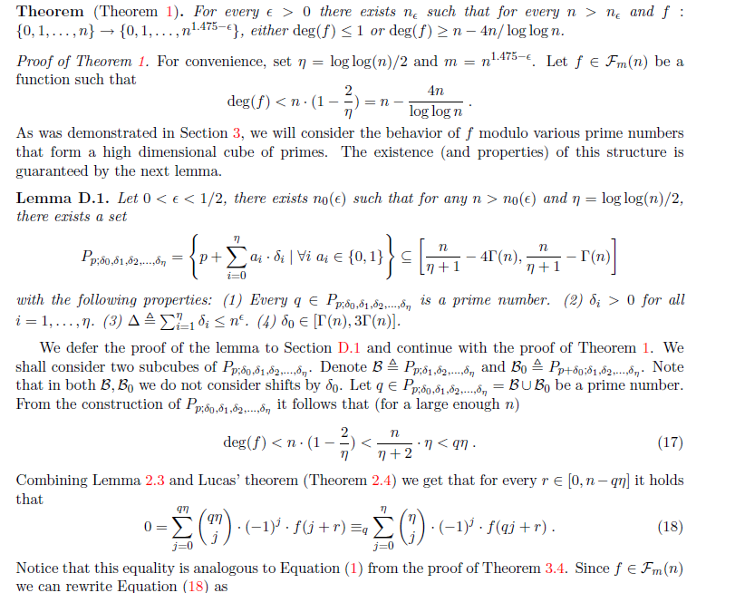
Theorem I
Proof of a weaker version

Slide 33
Proof of Theorem I (weak version)
Theorem. Let $f:\left\{0,…,n\right\}→\left\{0,…,n−1\right\}$ be non-constant. Then $deg\left(f\right)≥\frac{n}{6}−Γ\left(n\right)$.
Proof. By contradiction.
There exists a prime $p∈\left(\frac{n}{2},\frac{n}{2}+Γ\left(n\right)\right)$.
By [GR97], for $r=0,1,…,n−p$
$$0=\sum_{k=0}^{p}{{\left(−1\right)}^{k}⋅\left(\begin{aligned}p \\ k\end{aligned}\right)f\left(k+r\right)}$$

Slide 34
Proof of Theorem I (weak version)
By [GR97], for $r=0,1,…,n−p$
$$0=\sum_{k=0}^{p}{{\left(−1\right)}^{k}⋅\left(\begin{aligned}p \\ k\end{aligned}\right)f\left(k+r\right)}$$

Slide 35
Proof of Theorem I (weak version)
By [GR97], for $r=0,1,…,n−p$
$$0=\sum_{k=0}^{p}{{\left(−1\right)}^{k}⋅\left(\begin{aligned}p \\ k\end{aligned}\right)f\left(k+r\right)}$$
By Lucas Theorem, for $r=0,…,n−p$
$$0≡_{p}f\left(r\right)−f\left(p+r\right)$$
For $1≤k≤p−1$, $\left(\begin{aligned}p \\ k\end{aligned}\right)=\left(\begin{aligned}{\left\langle 1 0\right\rangle }_{p} \\ {\left\langle 0 k\right\rangle }_{p}\end{aligned}\right)≡_{p}0$
$$\left(\begin{aligned}p \\ 0\end{aligned}\right)=\left(\begin{aligned}p \\ p\end{aligned}\right)=1$$
Define the polynomial
$$g\left(x\right)=1+\frac{f\left(x\right)−f\left(p+x\right)}{p}$$

Slide 36
Proof of Theorem I (weak version)
By Lucas Theorem, for $r=0,…,n−p$
$$0≡_{p}f\left(r\right)−f\left(p+r\right)$$
Define the polynomial
$$g\left(x\right)=1+\frac{f\left(x\right)−f\left(p+x\right)}{p}$$

Slide 37
Proof of Theorem I (weak version)
By Lucas Theorem, for $r=0,…,n−p$
$$0≡_{p}f\left(r\right)−f\left(p+r\right)$$
Define the polynomial
$$g\left(x\right)=1+\frac{f\left(x\right)−f\left(p+x\right)}{p}$$
Since $p>n/2$
$$g:\left\{0,…,n−p\right\}→\left\{0,1,2\right\}$$

Slide 38
Proof of Theorem I (weak version)
$$g:\left\{0,…,n−p\right\}→\left\{0,1,2\right\}$$

Slide 39
Proof of Theorem I (weak version)
$$g:\left\{0,…,n−p\right\}→\left\{0,1,2\right\}$$
If $g$ is not a constant, then
$$deg\left(g\right)>\frac{n−p}{3}>\frac{n}{6}−Γ\left(n\right)$$

Slide 40
Proof of Theorem I (weak version)
$$g:\left\{0,…,n−p\right\}→\left\{0,1,2\right\}$$
Otherwise, since$g\left(x\right)=1+\frac{f\left(x\right)−f\left(p+x\right)}{p}$
$$0=\deg\left(g\right)≥\deg\left(f\right)−2+1=\deg\left(f\right)−1$$
Hence $f$ is linear. As $f$ takes integer values and its range is smaller than its domain, $f$ must be constant – a contradiction!
QED

Slide 41
How to get a stronger bound?
Modulo a prime is nicer to analyze though we loose information.
Natural idea: use many primes!
How does one combine all pieces of information from different primes?
The set of primes should have some structure.

Slide 42
A cube of primes
$$P_{p;δ_{1},…,δ_{k}}=\left\{p+\sum_{i=0}^{k}{a_{i}δ_{i}}:{∀i a}_{i}∈\left\{0,1\right\}\right\}$$
$$7 =7$$
$$11=7+4$$
Cube $\left(7;4,6\right)$
$$13=7+ 6$$
$$17=7+4+6$$
Lemma: $∃$cube with $Ω\left(\sqrt{\log{n}}\right)$ primes in $\left[n−o\left(n\right),n\right]$.

Slide 43
Theorem III
proof idea

Slide 44
Theorem III – proof idea
$$\left(\begin{matrix}0 \\ 0\end{matrix}\right)$$
$$\left(\begin{matrix}0 \\ 1\end{matrix}\right)$$
$$\left(\begin{matrix}0 \\ 2\end{matrix}\right)$$
$$n=4$$
$$d=2$$
$$\left(\begin{matrix}1 \\ 0\end{matrix}\right)$$
$$\left(\begin{matrix}1 \\ 1\end{matrix}\right)$$
$$\left(\begin{matrix}1 \\ 2\end{matrix}\right)$$
$$a_{0},…,a_{d}∈N$$
$$\left(\begin{matrix}2 \\ 0\end{matrix}\right)$$
$$\left(\begin{matrix}2 \\ 1\end{matrix}\right)$$
$$\left(\begin{matrix}2 \\ 2\end{matrix}\right)$$
$$∀j∈\left[n\right] \left|\sum_{i=0}^{d}{a_{i}}\left(\begin{matrix}j \\ i\end{matrix}\right)\right|≤m$$
$$\left(\begin{matrix}3 \\ 0\end{matrix}\right)$$
$$\left(\begin{matrix}3 \\ 1\end{matrix}\right)$$
$$\left(\begin{matrix}3 \\ 2\end{matrix}\right)$$
$$f\left(x\right)=\sum_{i=0}^{d}{a_{i}}\left(\begin{matrix}x \\ i\end{matrix}\right)$$
$$\left(\begin{matrix}4 \\ 0\end{matrix}\right)$$
$$\left(\begin{matrix}4 \\ 1\end{matrix}\right)$$
$$\left(\begin{matrix}4 \\ 2\end{matrix}\right)$$

Slide 45
Theorem III – proof idea
Proving the existence of a not too-high-degree polynomial with a given range boils down to proving the existence of a short vector in an appropriate lattice.
To avoid trivialities, we prove the existence of $>2d+1$ such vectors that are linearly independent. By the structure of the lattice this implies that one of them has degree $>2d$.

Slide 46
Open Questions

Slide 47
Open Questions
Break that $n−n^{0.525}$ barrier!
For $m=2$ the latter will improve the algorithm for learning symmetric juntas.
What is it with that third in Thm II?
Better upper bounds – if exist..
Find more applications ☺

Slide 48
Thank You!

