Slide 1
A trio talk - under the hood of
new extractor constructions
Eshan Chattopadhyay
IAS and Cornell
Gil Cohen
Princeton and Tel Aviv University
Xin Li
Johns Hopkins University

Slide 2
A Map

Slide 3
The Map of Explicit Extractors Constructions
Condensers
Codes
Ramsey Graphs
PRGs
Seeded Extractors
2-Source Extractors
Expanders
Mergers

Slide 4
The Map of Explicit Extractors Constructions
Ramsey Graphs
Alternating Extraction
Seeded Extractors
3-Source Extractors
2-Source Extractors
Non-Malleable Extractors
Privacy Amplification

Slide 5
The Map of Explicit Extractors Constructions
Ramsey Graphs
Alternating Extraction
Seeded Extractors
2.5-Source Extractors
2-Source Extractors
The Flip-Flop Primitive
Resilient Functions
Independence Preserving Mergers
Correlation Breakers
Non-Malleable Extractors
Privacy Amplification

Slide 6
The Map of Explicit Extractors Constructions
Ramsey Graphs
Alternating Extraction
Seeded Extractors
2.5-Source Extractors
2-Source Extractors
The Flip-Flop Primitive
Resilient Functions
Independence Preserving Mergers
Correlation Breakers
Non-Malleable Extractors
Privacy Amplification

Slide 7
The Map of Explicit Extractors Constructions
Ramsey Graphs
Alternating Extraction
Seeded Extractors
2.5-Source Extractors
2-Source Extractors
The Flip-Flop Primitive
Resilient Functions
Independence Preserving Mergers
Correlation Breakers
Non-Malleable Extractors
Privacy Amplification

Slide 8
Correlation Breakers with Advice

Slide 9

Correlation Breakers with Advice
Guarantee: a₁ $≠$ a₂
a₁
R₁
T₁
W
X
R₂
T₂
a₂

Slide 10
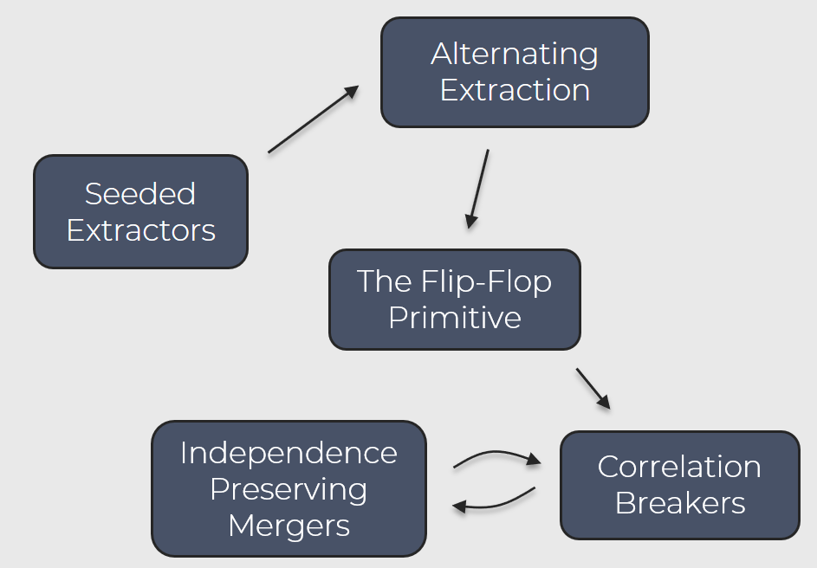
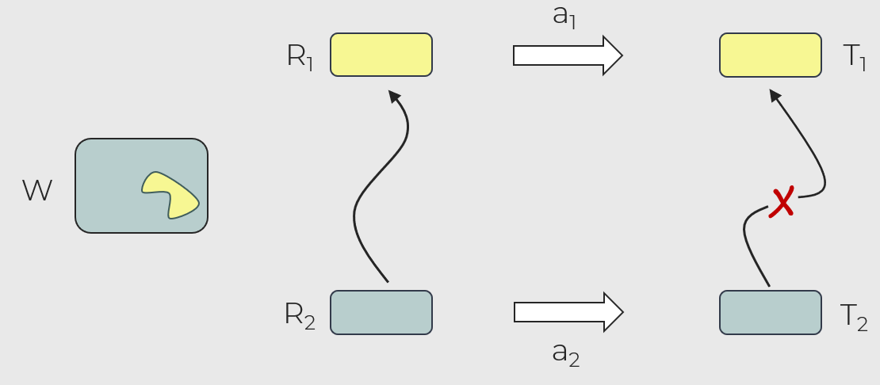

Correlation Breakers with Advice
“Formally”
Observation
* W has min-entropy k
* W independent of (R₁,R₂)
* R₁ ~ U
* a₁ $≠$a₂
The smaller the advice domain is, the easier it is to construct a CBA.
Construction strategy
T₁ = CBA(R₁,W,a₁)
T₂ = CBA(R₂,W,a₂)
* Construct a CBA for one bit of advice.
* Reduce the general case to the one bit case.
Then T₁ | T₂ ~ U
* Reductions use “advice condensing” and independence preserving mergers.

Slide 11
Hierarchy of Independence

Slide 12
Hierarchy of Independence
A
B
R₁
R₂
W

Slide 13
Hierarchy of Independence
A
B
R₁
R₂
W

Slide 14
Hierarchy of Independence
A
B
R₁
A₁ ~ U
R₂
W

Slide 15
Hierarchy of Independence
A
B
R₁
A₁ ~ U
R₂
B₁ | A₁ , A₂ ~ U
W

Slide 16
HOI via Alternating Extraction

Slide 17
HOI via Alternating Extraction
S
R
W
A = E(W,S)
T = E(R,A)
B = E(W,T)
(A,B) = HOI(R,W)

Slide 18
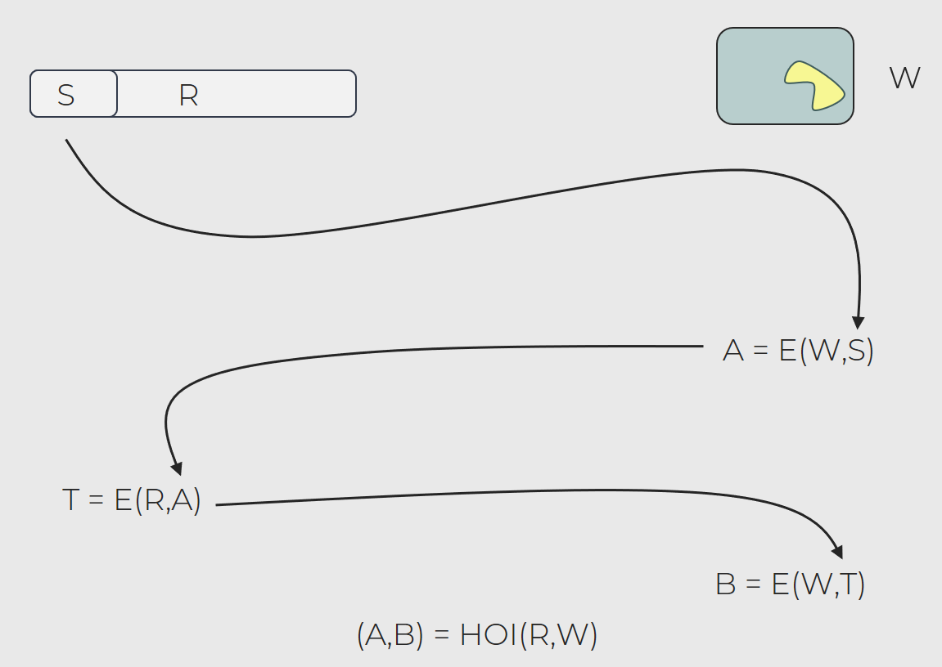
HOI via Alternating Extraction
Theorem (DP’07, DW’09)
* W has min-entropy k
* W independent of (R₁,R₂)
* R₁ ~ U
(A₁, B₁) = HOI(R₁,W),
(A₂, B₂) = HOI(R₂,W).
Then, B₁ | A₁, A₂ ~ U

Slide 19
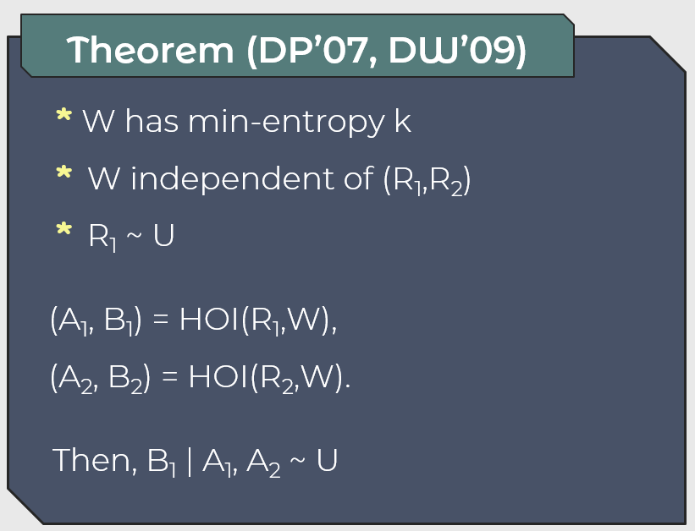
HOI via Alternating Extraction
S₁
R₁
W
S₂
R₂
A₁ = E(W,S₁)
A₂ = E(W,S₂)
T₁ = E(R₁,A₁)
T₂ = E(R₂,A₂)
B₁ = E(W,T₁)
B₂ = E(W,T₂)

Slide 20
HOI via Alternating Extraction
Fixed
s₁
R₁
W
S₂
R₂
A₁ = E(W,s₁)
A₂ = E(W,S₂)
T₁ = E(R₁,A₁)
T₂ = E(R₂,A₂)
B₁ = E(W,T₁)
B₂ = E(W,T₂)

Slide 21
HOI via Alternating Extraction
Fixed
s₁
R₁
W
Fixed
s₂
R₂
A₁ = E(W,s₁)
A₂ = E(W,s₂)
T₁ = E(R₁,A₁)
T₂ = E(R₂,A₂)
B₁ = E(W,T₁)
B₂ = E(W,T₂)

Slide 22
HOI via Alternating Extraction
Fixed
s₁
R₁
W
Fixed
s₂
R₂
Fixed
a₁ = E(W,s₁)
A₂ = E(W,s₂)
T₁ = E(R₁,a₁)
T₂ = E(R₂,A₂)
B₁ = E(W,T₁)
B₂ = E(W,T₂)

Slide 23
HOI via Alternating Extraction
Fixed
s₁
R₁
W
Fixed
s₂
R₂
Fixed
a₁ = E(W,s₁)
A₂ = E(W,s₂)
T₁ = E(R₁,a₁)
T₂ = E(R₂,A₂)
B₁ = E(W,T₁)
B₂ = E(W,T₂)

Slide 24
HOI via Alternating Extraction
Fixed
s₁
R₁
W
Fixed
s₂
R₂
Fixed
a₁ = E(W,s₁)
Fixed
a₂ = E(W,s₂)
T₁ = E(R₁,a₁)
T₂ = E(R₂,a₂)
B₁ = E(W,T₁)
B₂ = E(W,T₂)

Slide 25
HOI via Alternating Extraction
Fixed
s₁
R₁
W
Fixed
s₂
R₂
Fixed
a₁ = E(W,s₁)
Fixed
Fixed
a₂ = E(W,s₂)
t₁ = E(R₁,a₁)
T₂ = E(R₂,a₂)
B₁ = E(W,t₁)
B₂ = E(W,T₂)

Slide 26
The Flip Flop Primitive

Slide 27
The Flip-Flop Primitive
A
B
R₁
R₂
W

Slide 28
The Flip-Flop Primitive
A
B
R₁
R₂
W

Slide 29
The Flip-Flop Primitive
A
B
R₁
R’₁ = E(W,A₁)
R₂
R’₂ = E(W,B₂)
R’₁
R’₂
A’
B’
W

Slide 30
The Flip-Flop Primitive
A
B
R₁
R’₁ = E(W,A₁)
R₂
R’₂ = E(W,B₂)
R’₁
O₁ = E(W,B’₁)
R’₂
O₂ = E(W,A’₂)
A’
B’
W

Slide 31
Independence-Preserving Mergers

Slide 32
Independence Preserving Mergers
X
X
Thank you!

Slide 33
The Map of Explicit Extractors Constructions
Condensers
Challenge-Response Mechanism
2 Source Dispersers
Codes
PRGs
The Lightest Bin Protocol
Alternating Extraction
Ramsey Graphs
Seeded Extractors
2.5 Source Extractors
2 Source Extractors
The Flip-Flop Primitive
Resilient Functions
Independence Preserving Mergers
Mergers
Non-Malleable Extractors
Privacy Amplification
Expanders
Correlation Breakers

Slide 34
The Map of Explicit Extractors Constructions
Condensers
Challenge-Response Mechanism
2 Source Dispersers
Codes
PRGs
The Lightest Bin Protocol
Alternating Extraction
Ramsey Graphs
Seeded Extractors
2.5 Source Extractors
2 Source Extractors
The Flip-Flop Primitive
Resilient Functions
Independence Preserving Mergers
Mergers
Non-Malleable Extractors
Privacy Amplification
Expanders
Correlation Breakers

Slide 35
The Map of Explicit Extractors Constructions
Condensers
Challenge-Response Mechanism
2 Source Dispersers
Codes
PRGs
The Lightest Bin Protocol
Alternating Extraction
Ramsey Graphs
Seeded Extractors
2.5 Source Extractors
2 Source Extractors
The Flip-Flop Primitive
Resilient Functions
Independence Preserving Mergers
Mergers
Non-Malleable Extractors
Privacy Amplification
Expanders
Correlation Breakers

Slide 36

The Flip Flop Primitive
Correlation Breaker with Advice
A correlation breaker with advice is a function $CBA:\{0,1\}^{r}×\{0,1\}^{w}×\{0,1\}^{a}→{\left\{0,1\right\}}^{m}$ such that for every $r$-bit random variables $R_{1},R_{2}$ with $R_{1}$ uniform and for any independent $\left(w,k\right)$-source $W,$
$\left(CBA\left(R_{1},W,a_{1}\right),CBA\left(R_{2},W,a_{2}\right)\right)≈\left(U_{m},CBA\left(R_{2},W,a_{2}\right)\right)$.
Observation
The smaller the advice domain is, the easier it is to construct a CBA.

Slide 37

Strong Seeded Extractors
The Three Commandments
1. Thou shalt have enough min-entropy in the source.
2. Thou shalt use a uniform seed.
3. Thou shalt not use correlated source and seed.
Strong Seeded Extractors
A strong seeded extractor for min-entropy $k$ is a function $Ext:\{0,1\}^{n}×\{0,1\}^{d}→{\left\{0,1\right\}}^{m}$ such that for every $k$-source $X$ and an independent seed $S∼U_{d}$, $Ext\left(X,S\right)≈U_{m}$.

