Slide 1
Constructing Ramsey Graphs
(or Two-source dispersers for polylog-entropy and improved Ramsey graphs)
Gil Cohen

Slide 2
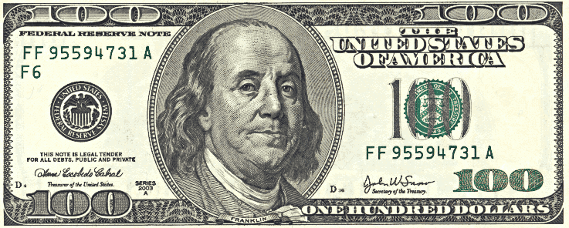
Ramsey graphs
Ramsey theory concerns the unavoidable presence of local structure in globally unstructured objects.
Definition
A $k$-Ramsey graph is a graph with no $k$-clique or $k$-independent set.
Ramsey’s Theorem (1928)
There is no $0.5⋅log⁡n$-Ramsey graph on $n$ vertices.
Theorem (Erdős 1947)
There exists a $2⋅log⁡n$-Ramsey graph on $n$ vertices.
Erdős’ proof is existential. Finding an explicit $c⋅log⁡n$-Ramsey graph, for a constant $c$, is a central open problem in combinatorics.

Slide 3
Previous work
Construction | $$k\left(n\right)$$
[Erdos’47] (non constructive) | $$2\log{n}$$
[Abbott’72] | $$n^{\log_{5}{2}}$$
[Nagy’75] | $$n^{1/3}$$
[Frankl’77] | $$n^{o\left(1\right)}$$
[Chung’81] | $$2^{O\left(\log^{3/4}{n} ⋅ \log^{1/4}{\log{n}}\right) }$$
[FranklWilson’81, Alon’98, Grolmusz’01, Barak’06] | $$2^{O\left(\sqrt{\log{n}⋅\log{\log{n}}}\right) }$$

Slide 4
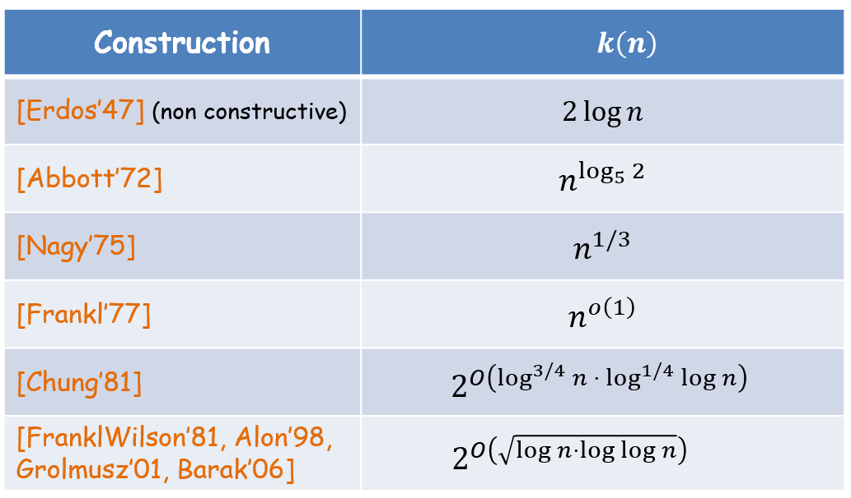
Previous work
Bipartite construction | $$k\left(n\right)$$
Folklore | $$\sqrt{n}$$
[PudlakRodl’04] | $$n^{\frac{1}{2}−o\left(1\right)}$$
[BarakKindlerShaltielSudakovWigderson’05] | $$2^{\frac{\log{n}}{\log{\log{n}}}}$$
[BarakRaoShaltielWigderson’06] | $$2^{2^{{\left(\log{\log{n}}\right)}^{0.9}}}$$

Slide 5
Our contribution
Main result
Explicit $2^{poly\left(\log{\log{n}}\right)}$-Ramsey-graph on $n$ vertices.
Soon afterwards matched by [ChattopadhyayZuckerman’15] using independent techniques.

Slide 6
Roadmap
* The problem at hand
* Rest of the talk – proof strategy in high-level
* Switching lingo
* Let’s continue from there
Graphs
Functions
Sets
Random variables

Slide 7
Dispersers
Definition (ChorGoldreich 1985)
A random variable $X$ is called a $k$-source if $∀x$ $\operatorname{Pr}\left[X=x\right]≤2^{−k}$.
The largest $k$ for which $X$ is a $k$-source is the min-entropy of $X$.
Definition
A function $D:{\left\{0,1\right\}}^{n}×{\left\{0,1\right\}}^{n}→\left\{0,1\right\}$ is called a disperser for min-entropy $k$ if for any independent $k$-sources $X$,$Y$, $D\left(X,Y\right)$ is non-constant.
Lemma
A disperser for min-entropy $k$ yields a $2^{k}$-Ramsey graph on $2^{n}$ vertices.
Main result in dispersers’ lingo
Explicit disperser for min-entropy $k=poly\left(\log{n}\right)$.

Slide 8
Block-sources
Definition (ChorGoldreich 1985)
An $n$-bit random variable $X=X_{1}X_{2}$ is called a $k$-block-source if
* $X_{1}$ is a $k$-source.
* Conditioned on any fixing of $X_{1}$, $X_{2}$ is a $k$-source.
Theorem (Li 2015)
For any $n$ and $k≥poly\left(\log{n}\right)$ there is an efficiently-computable function
$$BE:{\left\{0,1\right\}}^{n}×{\left\{0,1\right\}}^{n}→{\left\{0,1\right\}}^{}$$
such that for any $k$-block-source $X$ and an independent $k$-source $Y$, $BE\left(X,Y\right)$ has low bias.

Slide 9
Subsources and a chain-like rule
Recall the chain rule for Shannon entropy: $H\left(X_{1}X_{2}\right)=H\left(X_{1}\right)+H\left(X_{2}|X_{1}\right)$.
Unfortunately, there is no chain rule for min-entropy. Nevertheless, some sort of a chain-like rule can be salvaged!
Definition
A source $X′$ is a subsource of a source $X$ if $X^{′}=X∣(X∈A)$ for some $A$.
The deficiency of $X′$ in $X$ is $−\log_{2}\operatorname{Pr}\left[X∈A\right]$.
Chain-like rule for min-entropy
For any $b<\frac{k}{2}$ and a $k$-source $X$, there is a deficiency $2$ subsource $X′$ of $X$ such that one of the following holds:
* $X′$ is a $b$-block-source.
* $X_{1}^{′}$ is a $\left(k−b\right)$-source.
* For any fixing of $X_{1}^{′}$, $X_{2}^{′}$ a $\left(k−b\right)$-source.

Slide 10
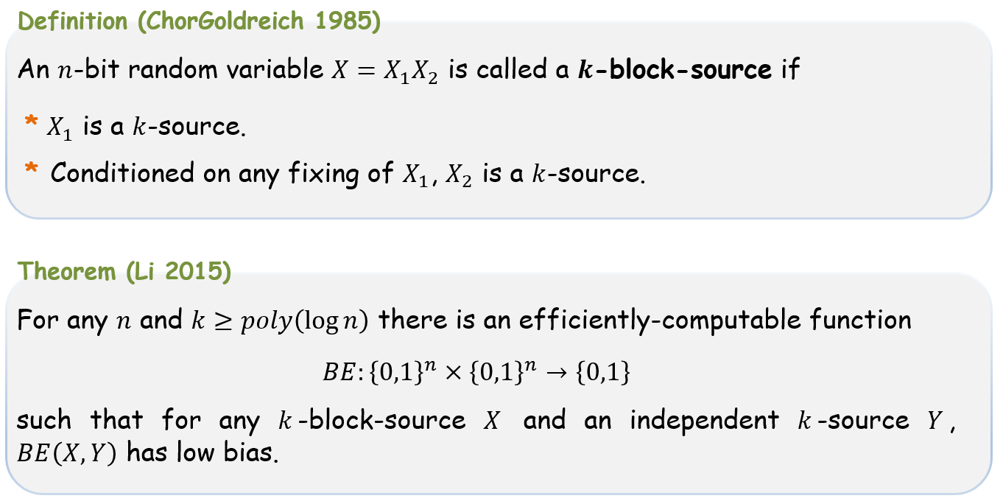
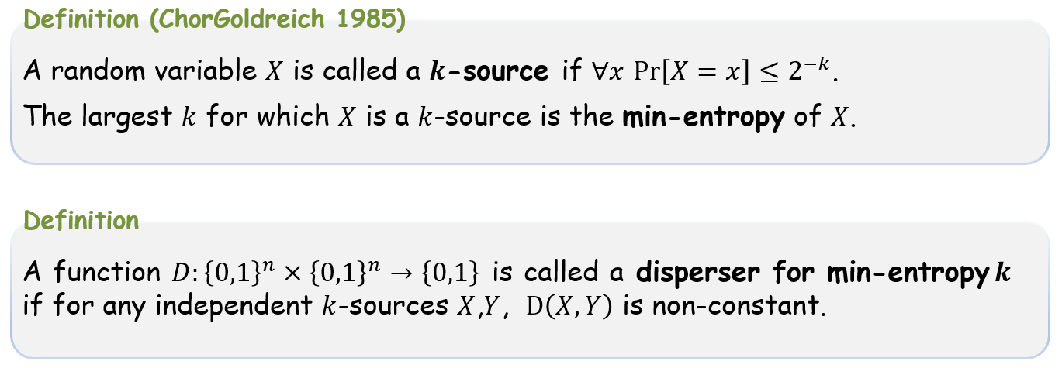
Roadmap
* The problem at hand
* Rest of the talk – proof strategy in high-level
* Switching lingo
* Dispersers and $k$-sources
* Block-sources and Li’s theorem
* A chain-like rule for min-entropy
* The high-level strategy

Slide 11
The high-level strategy
The high-level strategy
Given $x\sim X, y\sim Y$
* Compute $b=b\left(x,y\right)⊆\left[n\right]$ such that $X_{b}$ is a block-source
* Output $BE\left(x_{b},y\right)$
A bit fishy – $X_{b\left(X,Y\right)}$ and $Y$ are dependent!
The high-level strategy
Given $x\sim X, y\sim Y$
* Compute $b=b\left(x,y\right)⊆\left[n\right]$ such that $b$ is fixed on some subsources $X^{′}⊆X$, $Y^{′}⊆Y.$ Further, $X_{b}^{′}$ is a block-source.
* Output $BE\left(x_{b},y\right)$

Slide 12
The high-level strategy
The high-level strategy
Given $x\sim X, y\sim Y$
* Compute $b=b\left(x,y\right)⊆\left[n\right]$ such that $X_{b}$ is a block-source
* Output $BE\left(x_{b},y\right)$
A bit fishy – $X_{b\left(X,Y\right)}$ and $Y$ are dependent!
The high-level strategy
Given $x\sim X, y\sim Y$
* Compute $b=b\left(x,y\right)⊆\left[n\right]$ such that $b$ is fixed on some subsources $X^{′}⊆X$, $Y^{′}⊆Y.$ Further, $X_{b}^{′}$ is a block-source.
* Output $BE\left(x_{b},y\right)$

Slide 13
The high-level strategy
$$Y$$
$$Y′$$
$$1$$
$$X′$$
$$X$$
$$0$$
The high-level strategy
Given $x\sim X, y\sim Y$
* Compute $b=b\left(x,y\right)⊆\left[n\right]$ such that $b$ is fixed on some subsources $X^{′}⊆X$, $Y^{′}⊆Y.$ Further, $X_{b}^{′}$ is a block-source.
* Output $BE\left(x_{b},y\right)$

Slide 14
Roadmap
* The problem at hand
* Rest of the talk – proof strategy in high-level
* Switching lingo
* Dispersers and $k$-sources
* Block-sources and Li’s theorem
* A chain-like rule for min-entropy
* The high-level strategy
* Entropy trees

Slide 15
Entropy trees
Claim
Any $0.6n$-source has a deficiency $2$ subsource that is a $0.1n$-block-source.
Corollary
$BE$ is a disperser for entropies $0.6n$, $poly\left(\log{n}\right)$.

Slide 16
Entropy trees
Claim
Any $0.4n$-source $X$ has a deficiency $4$ subsource $X′$ such that one of the following holds:
* $X′$ is a $0.1n$-block-source.
* $X_{1}^{′}$ is a $0.1⋅\left(n/2\right)$-block-source.
* $X_{1}^{′}$ is fixed and $X_{2}^{′}$ a $0.1⋅\left(n/2\right)$-block-source.

Slide 17
Entropy trees
$X$ is a $k$-source
$$b=k/\log{n}$$

Slide 18
Entropy trees
$X$ is a $k$-source
F
$$b=k/\log{n}$$

Slide 19
Entropy trees
$X$ is a $k$-source
F
$$b=k/\log{n}$$

Slide 20
Entropy trees
$X$ is a $k$-source
F
$$b=k/\log{n}$$
F

Slide 21
Entropy trees
$X$ is a $k$-source
F
$$b=k/\log{n}$$
After $r$ steps we get a deficiency $2r$ source that has an $n⋅2^{−r}$ bit block that is a $\left(1−\frac{r}{\log{n}}\right)k$–source.
F
Thus, after $r<\log{n}$ steps, a block that is a $\frac{k}{\log{n}}$-block-source will be found.
B
Claim
Any $k$-source $X$ has a deficiency $2\log{n}$ subsource $X′$ that has this nice tree-structure.

Slide 22
Roadmap
* The problem at hand
* Rest of the talk – proof strategy in high-level
* Switching lingo
* Dispersers and $k$-sources
* Block-sources and Li’s theorem
* A chain-like rule for min-entropy
* The high-level strategy
* Entropy trees
* Revisiting the high-level strategy

Slide 23
The high-level strategy – revisited
The high-level strategy - revisited
Given $x\sim X, y\sim Y$
* Let $X′$ be the tree-structured subsource of $X$.
* Use $x,y$ to find $v_{B}$.
* Output $BE\left(x_{v_{B}},y\right)$
$$T_{X^{′}}$$
Unfortunately, we don’t know how to implement the second step. We overcome this by enforcing even more structure on the sources.
$$v_{B}$$

Slide 24
The structure we enforce
$$T_{X^{′}}$$

Slide 25
The structure we enforce
$$T_{X^{′}}$$

Slide 26
The structure we enforce
$$T_{X^{′}}$$
$$T_{Y^{′}}$$
$$u_{top}$$
$$v_{top}$$
$$u_{mid}$$
$$v_{mid}$$
$$u_{bot}$$
$$v_{bot}$$

Slide 27
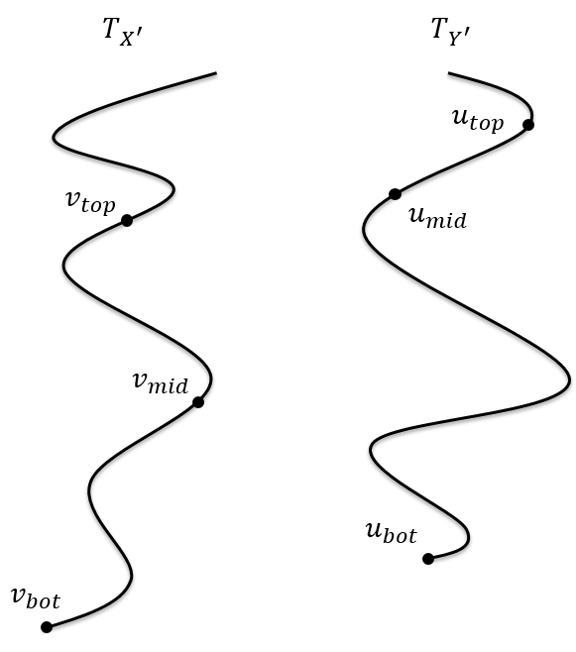
A more detailed strategy
A more detailed strategy
Given $x\sim X, y\sim Y$
* Let $X′$, $Y′$ be the nice subsources of $X$ and $Y$, respectively.
We do so correctly only on subsources of $X′$,$Y′$.
* Identify the entropy-paths of $T_{X^{′}}$ and $T_{Y^{′}}$.
* Find $v_{mid}$
* Output $BE\left(x_{v_{mid}}∘x,y\right)$
At this point we would like to output $BE\left(x_{v_{mid}},y\right)$. Unfortunately, the only way we know how to find $v_{mid}$ requires us to fix the left block of $X_{v_{mid}}^{′}$.

Slide 28
A more detailed strategy
A more detailed strategy
Given $x\sim X, y\sim Y$
* Let $X′$, $Y′$ be the nice subsources of $X$ and $Y$, respectively.
* Identify the entropy-paths of $T_{X^{′}}$ and $T_{Y^{′}}$.
* Find $v_{mid}$
* Output $BE\left(x_{v_{mid}}∘x,y\right)$
$$X_{v_{top}}^{′}$$
$$X_{v_{mid}}^{′}$$
F

Slide 29
Roadmap
* The problem at hand
* Rest of the talk – proof strategy in high-level
* Switching lingo
* Dispersers and $k$-sources
* Block-sources and Li’s theorem
* A chain-like rule for min-entropy
* The high-level strategy
* Entropy trees
* Revisiting the high-level strategy
* Next time
* Identifying the entropy paths
* Finding $v_{mid}$

Slide 30
Summary and open problems
* Quantitative improvement
Our result
$$2^{poly\left(\log{\log{n}}\right)}$$
Next natural goal
$$2^{O\left(\log{\log{n}}\right)}=poly\left(\log{n}\right)$$
Erdős’ challenge
$$2^{\log{\log{(n})}+O\left(1\right)}=O\left(\log{n}\right)$$
* Even a weaker notion of explicitness is interesting.
* A simple construction (like [FranklWilson’81]), even with weaker parameters.
Thanks!

