Slide 1
Efficient Multiparty Protocols via Log-Depth Threshold Formulae
Gil Cohen
Joint with: Ivan Damgard, Yuval Ishai, Jonas Kolker, Peter Bro Miltersen, Ran Raz and Ron Rothblum.

Slide 2
Secure Multiparty Computation
[Yao82, GoldreichMicaliWigderson87, BenOrGoldwasserWigderson88,
ChaumCrepeauDamgard88, RabinBenOr89, …]
$$f\left(x_{1},x_{2},…, x_{n}\right)$$
* An adversary controls a subset
of the parties.
f
f
$$p_{2}$$
$$p_{1}$$
* The adversary should learn
nothing more than what he could
figure out by itself.
$$x_{2}$$
$$x_{1}$$
$$p_{3}$$
f
$$x_{3}$$
* Can be either passive or active.
f
f
* Computationally unbounded
adversary.
$$x_{n}$$
$$x_{4}$$
$$p_{n}$$
$$p_{4}$$
* Secure point to point channels.

Slide 3
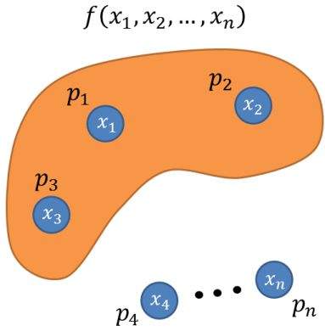
Secure Multiparty Computation
[Yao82, GoldreichMicaliWigderson87, BenOrGoldwasserWigderson88,
ChaumCrepeauDamgard88, RabinBenOr89, …]
Theorem [BenOrGoldwasserWigderson88, ChaumCrepeauDamgard88]. Any $f$ can be securely computed iff the adversary passively controls less than n/2 of the parties.
Theorem [BenOrGoldwasserWigderson88, ChaumCrepeauDamgard88]. Any $f$ can be securely computed iff the adversary actively controls less than n/3 of the parties.
* Fairly complicated protocols.
* Difficult to prove security [AsharovLindell11,
CramerDamgardNielsen].

Slide 4
Our Contribution
Main Contribution. Conceptually simple and flexible approach for designing MPC protocols.

Slide 5
Our Contribution
Main Contribution. Conceptually simple and flexible approach for designing MPC protocols.
Simplifications:
* MPC over fields [BenOrGoldwasserWigderson88, ChaumCrepeauDamgard88,…].
* MPC over rings [CramerFehrIshaiKushilevitz03, …].
* MPC over groups [DesmedtPieprzykSteinfeldWang07, …].
* Broadcast [PeaseShostakLamport80, Dolev82, … , FitziMaurer00].
Some New Results:
* First efficient MPC over groups protocol for active adversary.
* Improved protocol for MPC over groups for passive adversary.

Slide 6
Now to a completely different topic

Slide 7
Majority from Majorities
Theorem [Valiant84]. Majority can be computed by a log-depth Boolean monotone formula.
* Valiant’s proof is existential (in fact, randomized).
* Deterministic construction follows from [AjtaiKomlosSzemeredi83].
$$∨$$
$$∧$$
$$∧$$
$$∧$$
$$∨$$
$$x_{1}$$
$$x_{2}$$
$$⋯$$
$$x_{n}$$

Slide 8
Majority from Majorities
Theorem [BroMiltersen92, GuptaMahajan96, Zwick96, Goldreich11]. Majority can be computed by a log-depth formula consisting only of $M_{3}$ gates and no constants.
* Valiant’s proof is existential (in fact, randomized).
* Deterministic construction follows from [AjtaiKomlosSzemeredi83].
$$M_{3}$$
$$∨$$
$$∧$$
$$M_{3}$$
$$∧$$
$$M_{3}$$
$$∧$$
$$M_{3}$$
$$∨$$
$$M_{3}$$
$$x_{1}$$
$$x_{1}$$
$$x_{2}$$
$$x_{2}$$
$$⋯$$
$$⋯$$
$$x_{n}$$
$$x_{n}$$

Slide 9
Majority from Majorities
Theorem [BroMiltersen92, GuptaMahajan96, Zwick96, Goldreich11]. Majority can be computed by a log-depth formula consisting only of $M_{3}$ gates and no constants.
* Valiant’s proof is existential (in fact, randomized).
* Deterministic construction follows from [AjtaiKomlosSzemeredi83].
* The semantic is security.
$$M_{3}$$
$$M_{3}$$
$$M_{3}$$
$$M_{3}$$
$$M_{3}$$
$$x_{1}$$
$$x_{2}$$
$$⋯$$
$$x_{n}$$

Slide 10
Roadmap
* Secure multiparty computation
* Majority from majorities
* Secure MPC via majority from majorities
* Constructing a majority from majorities formula

Slide 11
Secure MPC via Majority from Majorities

Slide 12
The Ideal Protocol
$$p_{2}$$
$$p_{1}$$
$$x_{2}$$
$$x_{1}$$
$$x_{2}$$
$$x_{1}$$
$$τ$$
$$p_{3}$$
$$x_{3}$$
$$x_{3}$$
$$x_{4}$$
$$x_{n}$$
$$x_{4}$$
$$x_{n}$$
$$p_{4}$$
$$p_{n}$$
$$f\left(x_{1},x_{2},…, x_{n}\right)$$

Slide 13
The Ideal Protocol
$$p_{2}$$
$$p_{1}$$
$$x_{2}$$
$$f\left(\vec{x}\right)$$
$$x_{1}$$
$$f\left(\vec{x}\right)$$
$$τ$$
$$p_{3}$$
$$f\left(\vec{x}\right)$$
$$x_{3}$$
$$f\left(\vec{x}\right)$$
$$f\left(\vec{x}\right)$$
$$x_{4}$$
$$x_{n}$$
$$p_{4}$$
$$p_{n}$$
$$f\left(x_{1},x_{2},…, x_{n}\right)$$

Slide 14
MPC via Majority from Majorities (Passive)
$$p_{2}$$
$$p_{1}$$
$$x_{2}$$
$$f\left(\vec{x}\right)$$
$$x_{1}$$
$$x_{2}$$
[HirtMaurer00]
$$f\left(\vec{x}\right)$$
$$x_{1}$$
$$τ$$
$$p_{3}$$
$$v_{1}$$
$$f\left(\vec{x}\right)$$
$$x_{3}$$
$$x_{3}$$
$$v_{3}$$
$$v_{2}$$
$$τ$$
$$x_{4}$$
$$f\left(\vec{x}\right)$$
$$x_{n}$$
$$x_{4}$$
$$f\left(\vec{x}\right)$$
$$x_{n}$$
$$p_{4}$$
$$p_{n}$$
$$τ$$
* Reduce the problem of
constructing MPC for n
parties to a constant
number of parties (3 in
our case).
$$M_{3}$$
$$f\left(x_{1},x_{2},…, x_{n}\right)$$
$τ$ is secure iff at most one of $v_{1},v_{2},v_{3}$ is corrupted.
$$v_{1}$$
$$v_{2}$$
$$v_{3}$$
0 – secure
1 - corrupted

Slide 15
MPC via Majority from Majorities (Passive)
$$p_{2}$$
$$p_{1}$$
$$x_{2}$$
$$x_{1}$$
$$f\left(\vec{x}\right)$$
$$x_{2}$$
$$w_{3}$$
$$x_{1}$$
$$w_{1}$$
$$τ$$
$$p_{3}$$
$$f\left(\vec{x}\right)$$
$$f\left(\vec{x}\right)$$
$$x_{3}$$
$$x_{3}$$
$$w_{2}$$
$$v_{3}$$
$$v_{1}$$
$$x_{4}$$
$$x_{n}$$
$$τ$$
$$x_{4}$$
$$f\left(\vec{x}\right)$$
$$f\left(\vec{x}\right)$$
$$x_{n}$$
$$v_{2}$$
$$p_{4}$$
$$p_{n}$$
$$τ$$
$$f\left(x_{1},x_{2},…, x_{n}\right)$$
$$M_{3}$$
$$v_{1}$$
$$M_{3}$$
$$v_{2}$$
$$v_{3}$$
$$w_{1}$$
$$w_{2}$$
$$w_{3}$$

Slide 16
MPC via Majority from Majorities (Passive)
* Simulate the trusted party by the real players according to a
majority from majorities formula.
$$p_{1}$$
$$f:f_{1},f_{2},…,f_{s}$$
$$τ$$
$$M_{3}$$
$$p_{2}$$
$$v_{1}$$
$$v_{2}$$
$$τ$$
$$p_{3}$$
$$M_{3}$$
$$M_{3}$$
$$v_{3}$$
$$p_{4}$$
$$M_{3}$$
$$p_{5}$$
$$p_{1}$$
$$p_{2}$$
$$p_{3}$$
$$p_{4}$$
$$p_{5}$$

Slide 17
MPC via Majority from Majorities (Passive)
* Simulate the trusted party by the real players according to a
majority from majorities formula.
$$p_{1}$$
$$f:f_{1},f_{2},…,f_{s}$$
$$τ$$
$$M_{3}$$
$$p_{2}$$
$$v_{1}$$
$$v_{2}$$
$$τ$$
$$p_{3}$$
$$M_{3}$$
$$M_{3}$$
$$v_{3}$$
$$p_{4}$$
$$M_{3}$$
$$p_{5}$$
$$p_{1}$$
$$p_{2}$$
$$p_{3}$$
$$p_{4}$$
$$p_{5}$$

Slide 18
MPC via Majority from Majorities (Passive)
* Simulate the trusted party by the real players according to a
majority from majorities formula.
$$p_{1}$$
$$f:f_{1},f_{2},…,f_{s}$$
$$τ$$
$$M_{3}$$
$$p_{2}$$
$$v_{1}$$
$$v_{2}$$
$$τ$$
$$p_{3}$$
$$M_{3}$$
$$M_{3}$$
$$v_{3}$$
$$p_{4}$$
$$M_{3}$$
$$p_{5}$$
$$p_{1}$$
$$p_{2}$$
$$p_{3}$$
$$p_{4}$$
$$p_{5}$$

Slide 19
MPC via Majority from Majorities (Passive)
* Simulate the trusted party by the real players according to a
majority from majorities formula.
$$f_{1}:f_{1, 1},f_{1,2},…,f_{1,c}$$
$$p_{1}$$
$$τ$$
$$τ$$
$$M_{3}$$
$$p_{2}$$
$$v_{1}$$
$$v_{2}$$
$$v_{1}$$
$$p_{3}$$
$$M_{3}$$
$$M_{3}$$
$$p_{3}$$
$$v_{3}$$
$$v_{2}$$
$$p_{4}$$
$$M_{3}$$
$$p_{5}$$
$$p_{1}$$
$$p_{2}$$
$$p_{3}$$
$$p_{4}$$
$$p_{5}$$

Slide 20
MPC via Majority from Majorities (Passive)
* Simulate the trusted party by the real players according to a
majority from majorities formula.
$$τ$$
$$p_{1}$$
$$τ$$
$$p_{3}$$
$$M_{3}$$
$$p_{2}$$
$$v_{1}$$
$$v_{2}$$
$$v_{1}$$
$$p_{4}$$
$$p_{3}$$
$$M_{3}$$
$$M_{3}$$
$$v_{3}$$
$$p_{3}$$
$$v_{3}$$
$$p_{4}$$
$$M_{3}$$
$$p_{5}$$
$$p_{1}$$
$$p_{2}$$
$$p_{3}$$
$$p_{4}$$
$$p_{5}$$

Slide 21
MPC via Majority from Majorities (Passive)
* Simulate the trusted party by the real players according to a
majority from majorities formula.
$$τ$$
$$p_{1}$$
$$τ$$
$$p_{3}$$
$$M_{3}$$
$$p_{2}$$
$$v_{1}$$
$$v_{2}$$
$$v_{1}$$
$$p_{4}$$
$$p_{3}$$
$$M_{3}$$
$$M_{3}$$
$$p_{3}$$
$$p_{3}$$
$$v_{3}$$
$$p_{4}$$
$$p_{2}$$
$$v_{3}$$
$$M_{3}$$
$$p_{1}$$
$$p_{5}$$
$$p_{1}$$
$$p_{2}$$
$$p_{3}$$
$$p_{4}$$
$$p_{5}$$

Slide 22
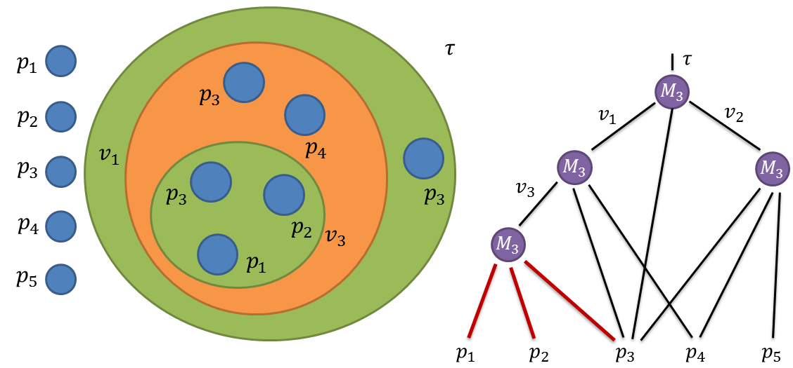
MPC via Majority from Majorities (Passive)
* Simulate the trusted party by the real players according to a
majority from majorities formula.
* The protocol is secure as long as the formula evaluates to 0 –
the majority of parties are not controlled by the adversary.
* Running-time is exponential in formula’s depth. So, log-depth
implies poly-time.
Log-depth majority from majorities formula
Efficient MPC protocol for n parties
MPC protocol for 3 parties
+
=>

Slide 23
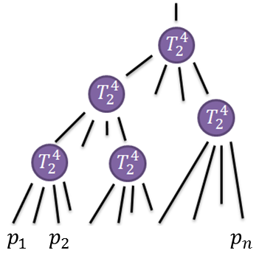
MPC via Threshold from Thresholds (Active)
* Atomic protocol is for 4 parties, 1 of which is compromised.
* Thus, formula now consists of 2-out-of-4 threshold gates.
* The protocol is secure as long as the formula evaluates to 0.
* Therefore, we wish to construct a 1/3-threshold formula
composed of 2-out-of-4 threshold gates.
Log-depth threshold from thresholds formula
Efficient MPC protocol for n parties
MPC protocol for 4 parties
+
=>

Slide 24
Roadmap
* Secure multiparty computation
* Majority from majorities
* Secure MPC via majority from majorities
* Constructing a majority from majorities formula

Slide 25
Majority from Majorities (and Threshold from Thresholds)

Slide 26
Majority of Majorities
* Valiant’s construction is randomized.
* The deterministic construction of [AjtaiKomlosSzemeredi83] does
not go through in the majority gates setting.
Theorem. There exists an explicit log-depth formula composed of $M_{3}$ gates that computes the majority value whenever at least 0.51 of the inputs agree.
$${\frac{1}{2}+2}^{−\sqrt{\log{n}}}$$
$\frac{1}{2}+\frac{1}{n}$ assuming standard hardness assumptions.

Slide 27
Threshold from Thresholds
* Does there exist a log-depth formula computing 1/3-threshold
function, composed only of 2-out-of-4 threshold gates?
* An argument similar to Valiant’s yields 0.23-threshold.
Theorem. There exists an explicit log-depth formula composed of j-out-of-k threshold gates that computes a “promise” (j-1)/(k-1)-threshold function.
* For j=2, k=4 we get a promise 1/3-threshold function.
* For j=2, k=3 we get a promise 1/2-threshold function.
* We show that with linear-depth the promise is not necessary.

Slide 28
Majority from Majorities for any constant promise

Slide 29
Majority from Majorities – Shrinker
$$x_{1}$$
$$x_{2}$$
$$x_{1}$$
$$M_{3}$$
$$x_{2}$$
$$M_{3}$$
$$y_{1}$$
$$M_{3}$$
$$M_{3}$$
$$y_{2}$$
$$M_{3}$$
$$M_{3}$$
$$M_{3}$$
$$M_{3}$$
$$y_{n/2}$$
$$x_{n}$$
Shrinker
$$x_{n}$$
$$\log\left(n\right)⋅$$
Shrinker’s
depth
Preserves promise
(to the right direction)

Slide 30
Shrinker via Expanders
Majority from majorities on $O\left(β^{−2}\right)$ inputs
* Compute via brute force a majority
from majorities on $O\left(β^{−2}\right)$ inputs.
$$n$$
$$n$$
0
$$O\left(β^{−2}\right)$$
* Poly-time even for slightly sub-
constant $β$.
$$\frac{1}{2}+β$$
$$\frac{3}{4}$$
1
$$\frac{7}{8}$$
1
0
Majority of neighbors is 1

Slide 31
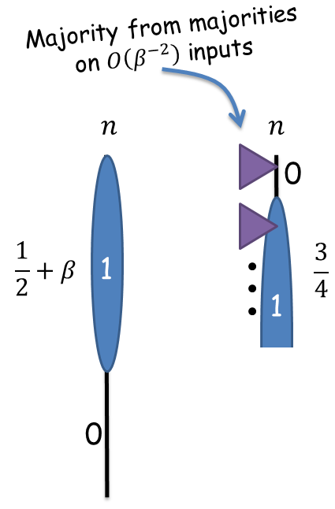
Majority from Majorities sub-constant promise
* To support promise $β=β\left(n\right)$ it is
enough to efficiently construct
$O\left(\log{n}\right)$-depth circuit on $O\left(1/β^{2}\right)$
inputs.

Slide 32
Valiant’s Proof
Theorem. Majority can be computed by a log-depth formula consisting only of $M_{3}$ gates and no constants.
Assume $\operatorname{Pr}\left[x_{i}=1\right]=1/2+β$ for $i=1,2,3$ independently.
So, $\operatorname{Pr}\left[y=1\right]=\left(\begin{aligned}3 \\ 2\end{aligned}\right){\left(\frac{1}{2}+β\right)}^{2}\left(\frac{1}{2}−β\right)+\left(\begin{aligned}3 \\ 3\end{aligned}\right){\left(\frac{1}{2}+β\right)}^{3}$
$$≥\frac{1}{2}+1.1⋅β$$
(for small enough $β$)
$$y$$
$$1.1β$$
$$M_{3}$$
Majority
$$x_{1}$$
$$x_{2}$$
$$x_{3}$$
$$β$$

Slide 33
Valiant’s Proof
* Uses $poly\left(n\right)$ random bits.
$$1$$
$$\frac{1}{2}+\frac{{1.1}^{2}}{n}$$
$$O\left(\log{n}\right)$$
Random wiring
$$\frac{1}{2}+\frac{1.1}{n}$$
$$\frac{1}{2}+\frac{1}{n}$$

Slide 34
Using Fewer Random Bits
* Uses $O\left(\log{m}\right)$ random bits for each of the $O\left(\log{m}\right)$ layers.
* Total of $O\left(\log^{2}{m}\right)$ random bits.
Majority from majorities for constant bias
* Outputs the correct answer
with probability 0.9.
* Depth $O\left(\log{m}\right)$.
$$0.51$$
$$\frac{1}{2}+\frac{{1.1}^{2}}{m}$$
6-wise independence
$$\frac{1}{2}+\frac{1.1}{m}$$
Random wiring
$$\frac{1}{2}+\frac{1}{m}$$

Slide 35
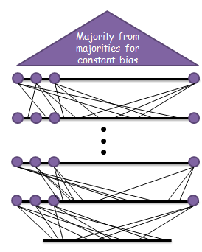
Using Fewer Random Bits
* Depth $O\left(\log^{2}{m}\right)$
* Running time $2^{O\left(\log^{2}{m}\right)}$.
* For $m=2^{\sqrt{\log{n}}}$ we get $poly\left(n\right)$-time and $O\left(\log{n}\right)$-depth.
* Use in shrinker to support bias $β=2^{−\sqrt{\log{n}}}$.
Majority
from majorities for constant bias
Circuit per seed
$$2^{O\left(\log^{2}{m}\right)}$$

Slide 36
Summary and Open Problems
* We present a conceptually simple “cook-book” for
designing MPC protocols.
* Uses a seemingly unrelated complexity-theoretic object.
Two Complexity-Theoretic Open Problems:
* Construct log-depth majority from majorities formula.
* Does there exist a log-depth formula with j-out-of-k
gates that computes (j-1)/(k- 1)-threshold function?
Thank you for your attention !

