Slide 1
Hitting Sets with Near-Optimal Error for Read-Once Branching Programs
Joint work with Mark Braverman and Sumegha Garg

Slide 2
Randomness in Computation

Slide 3
Randomness in Computation
Saks-Zhou’99
Interesting; not today
Any space 𝑠 two-sided error randomized algorithm can be simulated deterministically in space $O(s^{3/2} )$.
In particular, BPL $⊆$ L^{3/2}.
Equivalent to circuit lower bounds
Focus of this work

Slide 4
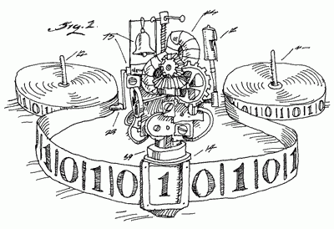
Randomness in Computation
Image shamefully taken from http://www.felienne.com/archives/2974
Input tape
Work tape
Randomness tape
Read only; back and forth
Read and write access; back and forth
Forward read only

Slide 5
Read Once Branching Programs

Slide 6
Read-Once Branching Programs (ROBPs)
Fact
$$R_{1}$$
$$R_{2}$$
$$R_{r}$$
$$0$$
For any Turing machine $M$ and input $x$, if $M$ on $x$ uses space $s$ and $r$ random bits then the running of $M$ on $x$ can be simulated by a width $2^{O(s)}$ length $r$ ROBP.
$$1$$
$$w$$
$$2^{s}$$
Corollary
To derandomize space $s$ randomized algorithms, it suffices to construct a PRG / hitting set for width $2^{s}$ length $r$ ROBPs.
$$r$$
$$n$$

Slide 7
PRGs and Hitting Sets for ROBPs
Definition - Pseudorandom distributions
A $\left(w,n,ε\right)$pseudorandom distribution is a distribution $D$ on $n$-bits such that for every width $w$ length $n$ ROBP $P$,
$Pr\left[P\left(D\right) accept\right]≈_{ε}Pr\left[P\left(U_{n}\right) accept\right]$.
A $(w,ε)$-PRG is a function $PRG:{\left\{0,1\right\}}^{s}→{\left\{0,1\right\}}^{n}$ such that $PRG\left(U_{s}\right)$ is a $\left(w,n,ε\right)$ pseudorandom distribution. The $s$-bit input is called a seed.
Definition – Hitting sets
A $\left(w,n,ε\right)$hitting set is a set $S⊆{\left\{0,1\right\}}^{n}$ such that for every width $w$ length $n$ ROBP $P$ for which $Pr\left[P\left(U_{n}\right) accept\right]≥ε$, there exists $s∈S$ such that $P(s)$ accepts.

Slide 8
PRGs and Hitting Sets for ROBPs
Fact
There exists a PRG with seed length $O\left(\log\left(\frac{n⋅w}{ε}\right)\right)$.
Nisan’92
Nisan’92
Explicit PRG with seed length $O\left(\log\left(\frac{n⋅w}{ε}\right)⋅\log{n}\right)$.
Explicit PRG with seed length $O\left(\log^{2}{n}+\log{n}⋅\log{w}+\log{n}⋅\log\left(1/ε\right)\right)$.
Raz-Reingold’99
Explicit PRG* with seed length $O\left(\log^{2}{n}+\log{w}+\log{n}⋅\log\left(1/ε\right)\right)$.

Slide 9
PRGs and Hitting Sets for ROBPs
Fact
There exists a PRG with seed length $O\left(\log\left(\frac{n⋅w}{ε}\right)\right)$.
Nisan’92
Nisan’92
Explicit PRG with seed length $O\left(\log\left(\frac{n⋅w}{ε}\right)⋅\log{n}\right)$.
Explicit PRG with seed length $O\left(\log^{2}{n}+\log{n}⋅\log{w}+\log{n}⋅\log\left(1/ε\right)\right)$.
Gopalan-Meka-Reingold-Trevisan-Vadhan’12
Explicit hitting sets with seed length $\tilde{O}\left(\log\left(n/ε\right)\right)$ for width 3 ROBPs.

Slide 10
PRGs and Hitting Sets for ROBPs
Fact
There exists a PRG with seed length $O\left(\log\left(\frac{n⋅w}{ε}\right)\right)$.
Nisan’92
Nisan’92
Explicit PRG with seed length $O\left(\log\left(\frac{n⋅w}{ε}\right)⋅\log{n}\right)$.
Explicit PRG with seed length $O\left(\log^{2}{n}+\log{n}⋅\log{w}+\log{n}⋅\log\left(1/ε\right)\right)$.
Braverman-Rao-Raz-Yehudayoff’10
Explicit PRG with seed length $\tilde{O}\left(\log{n}⋅\log\left(w/ε\right)\right)$ for regular ROBPs.

Slide 11
PRGs and Hitting Sets for ROBPs
Fact
There exists a PRG with seed length $O\left(\log\left(\frac{n⋅w}{ε}\right)\right)$.
Nisan’92
Nisan’92
Explicit PRG with seed length $O\left(\log\left(\frac{n⋅w}{ε}\right)⋅\log{n}\right)$.
Explicit PRG with seed length $O\left(\log^{2}{n}+\log{n}⋅\log{w}+\log{n}⋅\log\left(1/ε\right)\right)$.
Reingold’08
SL $=$ L

Slide 12
PRGs and Hitting Sets for ROBPs
Fact
There exists a PRG with seed length $O\left(\log\left(\frac{n⋅w}{ε}\right)\right)$.
Nisan’92
Nisan’92
Explicit PRG with seed length $O\left(\log\left(\frac{n⋅w}{ε}\right)⋅\log{n}\right)$.
Explicit PRG with seed length $O\left(\log^{2}{n}+\log{n}⋅\log{w}+\log{n}⋅\log\left(1/ε\right)\right)$.
Almost everyone doing pseudorandomness
Better constructions for restricted models.

Slide 13
Main Result

Slide 14
Main Result
Main result
Main result
Explicit hitting set with seed length $\tilde{O}\left(\log^{2}{n}+\log{n}⋅\log{w}+\log\left(1/ε\right)\right)$.
Explicit pseudorandom pseudo-distribution with seed length $\tilde{O}\left(\log^{2}{n}+\log{n}⋅\log{w}+\log\left(1/ε\right)\right)$.
Motivating observation
Explicit PRG with seed length $O\left(\log^{2}{n}+\log{w}+\log\left(1/ε\right)\right)$ would yield BPL $⊆$ L^{4/3}.
Definition – Pseudorandom pseudo-distribution
A $\left(w,n,ε\right)$pseudorandom pseudo-distribution is a sequence $\left(ρ_{1},p_{1}\right),…,\left(ρ_{S},p_{S}\right)$ of ${R×\left\{0,1\right\}}^{n}$ such that for every width $w$ length $n$ ROBP $P$,
$\sum{ρ_{i}}1_{p_{i} accepts}≈_{ε}Pr\left[P\left(U_{n}\right) accepts\right]$.

Slide 15
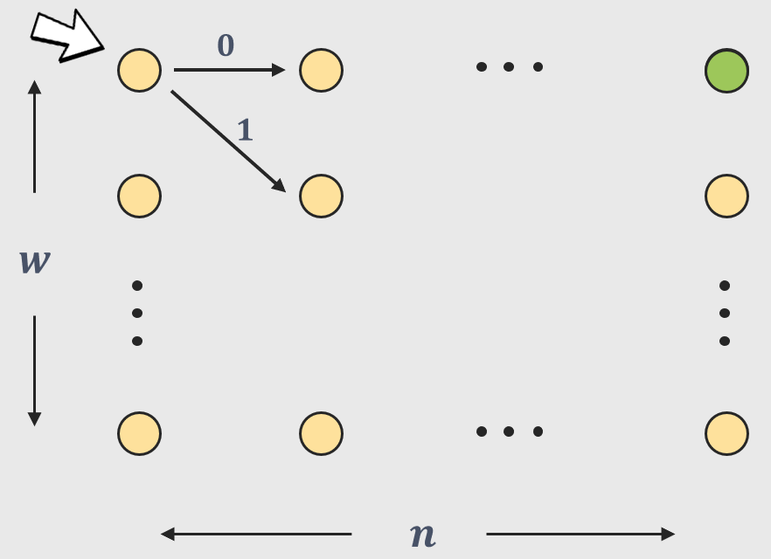

$$A^{n}$$
The Matrix-Theoretic Perspective

Slide 16
The Matrix-Theoretic Perspective
The Matrix Powering Problem
Given a $w×w$ stochastic matrix $A$, entries $i,j∈\left[w\right]$, and an integer $n$, approximate ${\left(A^{n}\right)}_{i,j}$ up to an additive error $ε$.
Natural recursive algorithm
Space complexity $O\left(\log{n}⋅\log\left(w/ε\right)\right)$.
Saks-Zhou’99
Space complexity $O\left(\sqrt{\log{n}}⋅\log\left(w/ε\right)\right)$.

Slide 17
The Matrix-Theoretic Perspective
The Matrix Powering Problem
$$A= \frac{1}{2}A_{0}+\frac{1}{2}A_{1}$$
$$A^{2}= \frac{1}{4}A_{0}A_{0}+\frac{1}{4}A_{0}A_{1}+\frac{1}{4}A_{1}A_{0}+\frac{1}{4}A_{1}A_{1}$$
$$= \frac{1}{4}\left(A_{00}+A_{01}+A_{10}+A_{11}\right)$$
$$A^{n}= \frac{1}{2^{n}}\sum_{s∈{\left\{0,1\right\}}^{n}}{A_{s}}$$
$$A^{n}≈_{ε} \frac{1}{\left|D\right|}\sum_{s∈D}{A_{s}}$$

Slide 18
Derandomized Matrix Product
The naïve product
How to define the derandomized product
Representation vs. matrix
$$A≈_{ε} \frac{1}{2^{r}}\sum_{s∈{\left\{0,1\right\}}^{r}}{A_{s}}$$
Nisan’92 Hash functions
$A$ is a data structure consisting of a sequence matrices ${\left(A_{s}\right)}_{s∈{\left\{0,1\right\}}^{r}}$. $\left\langle A\right\rangle$ is the matrix obtained by taking their average.
$$=\left\langle A\right\rangle$$
Nisan-Zuckerman’96 Extractors
$$B≈_{ε} \frac{1}{2^{r}}\sum_{s∈{\left\{0,1\right\}}^{r}}{B_{s}}=\left\langle B\right\rangle$$
Impagliazzo-Nisan-Wigderon’94 Expanders
$$AB≈_{2ε}\left\langle A\right\rangle \left\langle B\right\rangle = \frac{1}{2^{2r}}\sum_{s,t∈{\left\{0,1\right\}}^{r}}{A_{s}B_{t}}=\left\langle A∘B\right\rangle$$
Raz-Reingold’99 Extractors, Condensers
We use Samplers
$$d=O\left(\log\left(w/δ\right)\right)$$
The derandomized product
Back of the envelope calculation
$$\left\langle A∘_{d}B\right\rangle ≈_{δ}\left\langle A\right\rangle \left\langle B\right\rangle = \frac{1}{2^{r+d}}\sum_{\begin{aligned}s∈{\left\{0,1\right\}}^{r} \\ t∈{\left\{0,1\right\}}^{d}\end{aligned}}{A_{s}B_{f\left(s,t\right)}}$$
$$ε\left(n\right)=2ε\left(\frac{n}{2}\right)+δ=⋯=nδ=ε_{total}$$
$$r\left(n\right)=r\left(\frac{n}{2}\right)+\log\left(\frac{nw}{ε_{total}}\right)=⋯=\log{n}⋅\log\left(\frac{nw}{ε_{total}}\right)$$
$$\left\langle A∘_{d}B\right\rangle ≈_{2ε+δ}AB$$

Slide 19
The Idea

Slide 20
The Delta Product
A suggestive sum
A suggestive sum
The delta product
$$g≪k=\log\left(nw/ε\right)$$
$$g≪k=\log\left(nw/ε\right)$$
We define a product $A∘_{D−d}B$ having 3 properties:
$$=\left\langle A∘_{g}B\right\rangle +$$
$$\left\langle A∘_{k}B\right\rangle$$
$$=\left\langle A∘_{g}B\right\rangle +$$
$$\left\langle A∘_{k}B\right\rangle$$
Linearity. $\left\langle A∘_{D−d}B\right\rangle =\left\langle A∘_{D}B\right\rangle −\left\langle A∘_{d}B\right\rangle$
$$\left\langle A∘_{2g−g}B\right\rangle +$$
$$\left\langle A∘_{2g}B\right\rangle −\left\langle A∘_{g}B\right\rangle +$$
With the data structure $A$, we associate a real number $σ\left(A\right)$ called smallness such that:
$$\left\langle A∘_{4g−2g}B\right\rangle +$$
$$\left\langle A∘_{4g}B\right\rangle −\left\langle A∘_{2g}B\right\rangle +$$
$$⋮$$
Smallness is stored. $σ\left(A∘_{D−d}B\right)=σ\left(A\right)+σ\left(B\right)+d$
$$⋮$$
$$\left\langle A∘_{k−k/2}B\right\rangle$$
$$\left\langle A∘_{k}B\right\rangle −\left\langle A∘_{k/2}B\right\rangle$$
Smallness implies small norm. $σ\left(A\right)≥d →$ $\left\|A\right\|≤2^{−d}$.
Error term pieces
For closure, the data structure now contains pieces with different smallness.

Slide 21
Multiplying the New Data Structures
The new data structure
The data structure $A$ consists of pieces ${A_{0},A}_{g},A_{2g},A_{3g},…,A_{k}$ where $A_{i}$ has smallness $i$. $\left\langle A\right\rangle =\left\langle A_{0}\right\rangle +\left\langle A_{g}\right\rangle +\left\langle A_{2g}\right\rangle +⋯+\left\langle A_{k}\right\rangle$.
Multiplying under the new data structure
$\left\langle A\right\rangle \left\langle B\right\rangle =\sum_{i,j }{\left\langle A_{i}\right\rangle \left\langle B_{j}\right\rangle }$. So now we need to define a product between pieces that approximates $\left\langle A_{i}\right\rangle \left\langle B_{j}\right\rangle$.

Slide 22
Multiplying the New Data Structures
$$A_{0}$$
$$A_{g}$$
$$…$$
$$A_{g}$$
$$A_{2g}$$
$$A_{2g}$$
$$A_{k}$$
$$B_{0}$$
$$B_{g}$$
$$…$$
$$B_{g}$$
$$B_{2g}$$
$$B_{k}$$
$$σ=g$$
$$σ=2g$$
$$σ=3g$$
$$σ=4g$$
$$σ=k+3g$$
$$…$$
$$A_{g}∘_{g}B_{2g}$$
$$A_{g}∘_{2g−g}B_{2g}$$
$$A_{g}∘_{2k−k}B_{2g}$$
$$…$$
$$A_{g}∘_{g}B_{g}$$
$$A_{g}∘_{2g−g}B_{g}$$

Slide 23
Multiplying the New Data Structures
$$A_{0}$$
$$A_{g}$$
$$A_{2g}$$
$$…$$
$$A_{k}$$
$$B_{0}$$
$$B_{g}$$
$$B_{2g}$$
$$…$$
$$B_{k}$$
$$…$$
$$σ=0$$
$$σ=g$$
$$σ=2g$$
$$σ=k$$
“$+"$
$$…$$
$$k^{2}$$
$$…$$
$$…$$
$$…$$
$$…$$
$$C_{0}$$
$$C_{g}$$
$$C_{2g}$$
$$C_{k}$$

Slide 24
Some More Bits About the Proof
Parameters
Seed length $k\log{k}+g\log{n}$
$$ε_{total}≤w⋅k^{\frac{k⋅\log{n}}{g}}⋅2^{−k}$$
By setting $g=2\log{n}⋅\log{k}$ we get $ε_{total}≤w⋅2^{−k/2}$ and so we take $k=2\log\left(w/ε_{total}\right)$which gives the declared seed length.

Slide 25
Some More Bits About the Proof
More on the proof
Multiplying pieces of roughly the same smallness is done differently than multiplying pieces with significantly different smallness. This is where samplers are used.
Multiplying the first piece (which has no smallness) is done differently and requires its own multiplication rule.
For all of this to work, each $A_{i}$ is by itself a sequence of weighted sequences of stochastic matrices.

Slide 26
Summary and Open Problems

Slide 27
Summary and Open Problems
Summary
We give a hitting set that has optimal dependence on the error guarantee $ε$.
In fact, we introduce and obtain pseudorandom pseudo-distributions.
One of two steps towards BPL $⊆$ L^{4/3}.
Open problems
Collapse BPL or even RL to L^{1.49}
Improve the dependence on $w$ or on $n$.
Better-than-Nisan hitting sets even for width $w=4$.
Thank you!
Other applications of pseudorandom pseudo-distributions.

