Slide 1
Non-Malleable Extractors New tools and improved constructions
Gil Cohen

Slide 2
Seeded Extractors
Meta definition
A randomness extractor is a function that transforms a “weak source of randomness” to one that is close to uniform.
Definition (NisanZuckerman’93)
all seeds ${s∈\left\{0,1\right\}}^{d}$
$$Ext\left(X,s\right)\sim U$$
$Ext:{\left\{0,1\right\}}^{n}×{\left\{0,1\right\}}^{d}→{\left\{0,1\right\}}^{m}$ is a $k$-seeded extractor if for any random variable $X$ having entropy $k$, $Ext\left(X,s\right)\sim U$ for a typical $s∈{\left\{0,1\right\}}^{d}$.
$$s$$
Goal
Construct extractors with short seeds that support low entropy and output many bits.
bad seeds for the source $X$
[NisanZuckerman’93,Trevisan’99, LuReingoldVadhanWigderson’03, Guruswami-UmansVadhan’07, DvirKoppartySarafSudan’09,…] explicit extractors that output almost all of the entropy, for any entropy bound, using logarithmic seeds.

Slide 3
Non-Malleable Extractors
Definition (DodisWichs’09)
A seeded extractor is non-malleable if for any source $X$, any good seed $s$, and any $s^{′}≠s$, $Ext\left(X,s\right)\sim U$ conditioned on $Ext\left(X,s′\right)$.
Natural (and also in retrospective useful) to consider $t$-non-malleable extractors [C-RazSegev’12].
all seeds ${s∈\left\{0,1\right\}}^{d}$
Applications
$$Ext\left(X,s\right)\sim U$$
$$s$$
* Privacy amplification [DodisWichs’09]
* Two-source extractors [ChattopadhyayZuckerman’15]
$$s′′$$
$$s′$$
$$Ext\left(X,s′′\right)$$
$$Ext\left(X,s′\right)$$
bad seeds for the source $X$

Slide 4
Previous Work and Our Contribution
Construction | Seed length $d$ | Supported entropy $k$
[DodisWichs’09] (non constructive) | $$\log{n}$$ | $$\log{\log{n}}$$
[LiWooleyZuckerman’11] | $$n$$ | $$0.501n$$
[C-RazSegev’11] | $$\log{n}$$ | $$0.501n$$
[LiWooleyZuckermanDodis’11, Li’12a] | $$\log{n}$$ | $$0.501n$$
[Li’12b] | $$\log{n}$$ | $$0.499n$$
[ChattopadhyayGoyalLi’15] | $$\log^{2}{n}$$ | $$\log^{2}{n}$$
This work - construction I | $$\log{n}⋅\log{\log{n}}$$ | $$\log{n}$$
This work – construction II | $$\log{n}$$ | $$\frac{n}{poly\log{n}}$$

Slide 5
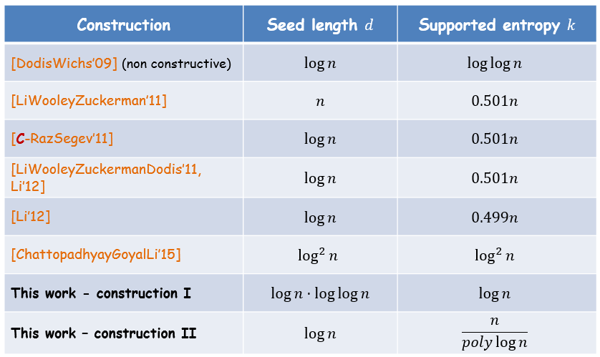
Previous Work and Our Contribution
Reducing entropy requirement
NM-extractor for entropy $k$ with seed length $d$
NM-extractor for entropy $k/d^{Ω\left(1\right)}$, with seed length $O\left(d\right)$
Increasing output length
NM-extractor with $Ω\left(1\right)$ output bits and seed length $d$
NM-extractor with $Ω\left(k\right)$ output bits and seed length $O\left(d\right)$
Increasing $t$
“Standard” NM-extractor
$t$-NM extractor

Slide 6
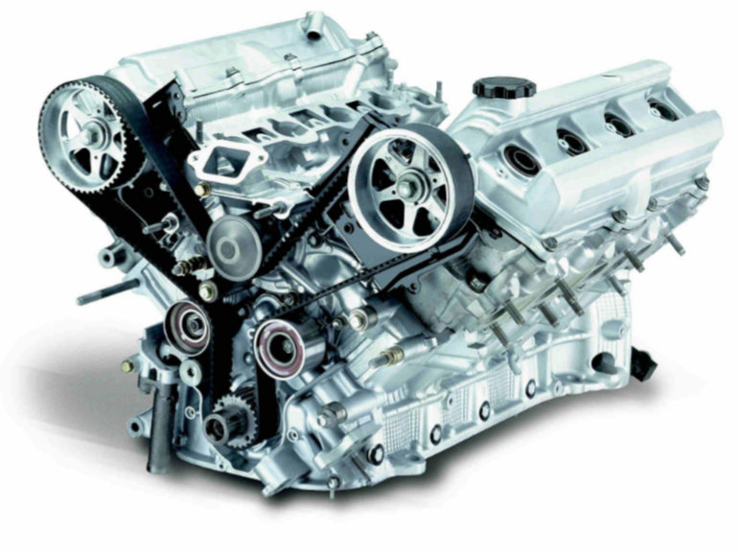
Correlation Breakers

Slide 7
Correlation Breakers
$$X$$
$$α$$
The Flip-Flop primitive [C’15] is a CB for $a=1$.
CB
$$Y$$
$$Z$$
By adapting the construction of local correlation breakers [C’15], it was shown by [ChattopadhyayGoyal-Li’15] that a sequential application of the Flip-Flip primitive yields CB for arbitrary advice length.
CB
$$Y′$$
$$Z′$$
$$X′$$
$$X$$
$$α′$$
Definition
A correlation breaker with advice is a function $CB:{\left\{0,1\right\}}^{ℓ}×{\left\{0,1\right\}}^{n}×{\left\{0,1\right\}}^{a}→{\left\{0,1\right\}}^{ℓ}$ such that for any $Y\sim U_{ℓ}$, weak-source $X$, and $Y^{′},X′$ such that $\left(Y,Y′\right)$ independent of $\left(X,X′\right)$, for any fixed $a$-bit strings $α≠α′$
$$\left(CB\left(Y,X,α\right),CB\left(Y^{′},X^{′},α′\right)\right)\sim \left(U,CB\left(Y^{′},X^{′},α′\right)\right)$$

Slide 8
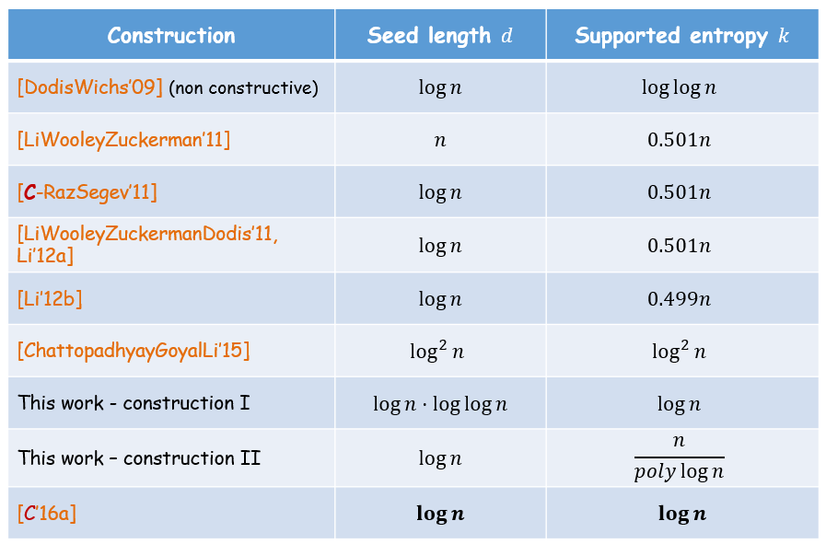
2016
* In [C-Schulman’16] CB were used to construct multi-source extractors. Main new pseudorandom primitive – independence preserving mergers (IPM).
* In [C’16a] NM-Ext with seed length $O\left(\log{n}\right)$ were constructed for any min-entropy $k=Ω\left(\log{n}\right)$. Main idea is to use CB (also) for generating the advice.
* Based on IPM, [ChattopadhyayLi’16] obtained incomparable NM-Ext with improved error dependence.
!
All these works rely on the Flip-Flop based CB. Circumventing in different ways the fact that its randomness requirement is linear in the advice length $a$.
* In [C’16b] a CB with optimal $Θ\left(\log{a}\right)$ randomness requirement was obtained. One application is a NM-Ext with near-optimal seed length $d=\log{n}+\log^{1+o\left(1\right)}\left(1/ε\right)$, output length $0.49k$, and supported entropy $Ω\left(d\right)$.
Thanks!

