Slide 1
Zero-Fixing Extractors for Sub-Logarithmic Entropy
Gil Cohen and Igor Shinkar

Slide 2
The Bit-Fixing Extractors Problem
0
0
1
0
0
1
1
1
0
0
1
1
0
0
0
0
1
0
1
0
1
1
Assumption. $k$ of the $n$ bits are jointly uniform. The rest are fixed.
A random variable with such distribution is called an $(n,k)$-bit-fixing source [Vaz’85, BenBraRob’85, ChoGolHasFriRudSmo’85].
Goal. Extract the randomness from bit-fixing sources.
Ext
$$x∈{\left\{0,1\right\}}^{n}$$
$$Ext\left(x\right)∈{\left\{0,1\right\}}^{m}$$
* For any$(n,k)$-bit-fixing source $X$, $Ext\left(X\right)$ is close to uniform.
* Maximize $m$ (clearly, $m≤k$).
* $Ext$ is computable in $poly(n)$-time.

Slide 3
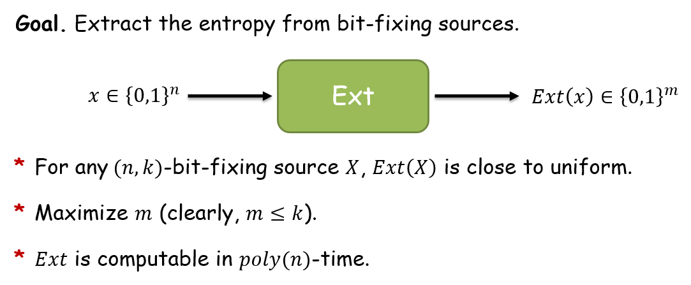
The Bit-Fixing Extractors Problem
Two easy facts:
* If $k>2\log{n}$ then most functions $f:{\left\{0,1\right\}}^{n}→{\left\{0,1\right\}}^{m}$ are $(n,k)$-
bit-fixing extractors with $m = k−O(1)$ output bits.
* If $k<0.5\log{n}$ then most functions $f:{\left\{0,1\right\}}^{n}→{\left\{0,1\right\}}^{1}$ are not
$(n,k)$-bit-fixing extractors.
[GabRazSha’06, Rao’09]
[Vaz’85,BBR’85,CGHFRS’85]
?
[KamZuc’06]
$$1$$
$$\log{n}$$
$$poly\log{n}$$
$$\sqrt{n}$$
$$\frac{n}{2}$$
$$n$$
Theorem [KamZuc’06]. For any k, there is an efficient and simple extractor with $0.5\log{(k)}−O(1)$ output bits.
Theorem [ResVad’10]. Space-bounded streaming algorithms cannot extract $ω\left(\log{k}\right)$ bits for $k=o\left(\log{n}\right)$.

Slide 4
Our Contribution
[GRS’06, Rao’09]
[Vaz’85,BBR’85,CGHFRS’85]
Theorem 2
Theorem 1
[KZ’06]
$$1$$
$${\left(\log^{∗}{n}\right)}^{2/3}$$
$$\log{\log{n}}$$
$$\log{n}$$
$$poly\log{n}$$
$$\sqrt{n}$$
$$\frac{n}{2}$$
$$n$$
No algorithm can extract more than $0.5\log{(k)}+Ω(1)$ bits.
One can extract$k−O(1)$ bits.
Running-time $n^{{\left(\log{\log{n}}\right)}^{2}}$.
Even when the fixed bits are set to 0 !
Theorem 1. The threshold, if exists, for extracting all the randomness is not at $\log{n}$.
Theorem 2. When k is small enough, only a logarithmic amount of the entropy is accessible, information-theoretically.
Theorem 2. When k is small enough, only a logarithmic amount of the entropy is accessible, information-theoretically.
Theorem 3. There exists an efficient extractor for $(n,k)$-zero-fixing sources for any $k≥{\left(\log{\log{n}}\right)}^{2.01}$ with $Ω\left(k\right)$ output bits.

Slide 5
Proof sketch for the impossibility result
By the pigeonhole principle, there exist $n⋅2^{−m}$ weight 1 vectors on which $f$ is constant.
If $n⋅2^{−m}≥2$ we found an $(n,2)$-zero-fixing source on which $f$ is symmetric.
Weight 2 vectors
$$e_{1},…,e_{n}$$
The all-zeros vector

Slide 6
Proof sketch for the impossibility result
By the pigeonhole principle, there exist $n⋅2^{−m}$ weight 1 vectors on which $f$ is constant.
If $n⋅2^{−m}≥2$ we found an $(n,2)$-zero-fixing source on which $f$ is symmetric.
Consider the complete graph on $n⋅2^{−m}$ vertices corresponding to the “surviving” indices. Each edge $i,j$ is colored by $f\left(e_{i}+e_{j}\right)$.
$$j$$
$$i$$
$$f\left(e_{i}+e_{j}\right)$$
By the (multi-colored variant of) Ramsey theorem, there exists a monochromatic clique of size $2^{−O(m)}⋅log{n}$ in this graph.
If $2^{−O(m)}⋅log{n}≥3$, we found an $(n,3)$-zero-fixing source on which $f$ is symmetric.
Weight 2 vectors
$$e_{1},…,e_{n}$$
The all-zeros vector

Slide 7
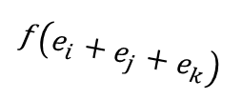
Proof sketch for the impossibility result
To find an $(n,4)$-zero-fixing source on which $f$ is symmetric, we consider the 3-uniform hypergraph on the “surviving” vertices .
By the (multi-colored variant of) Ramsey theorem for hyper- graphs, there exists a monochromatic clique of size $2^{−O(m)}⋅log log log{n}$ in this hypergraph.
$$i$$
$$f\left(e_{i}+e_{j}+e_{k}\right)$$
$$j$$
$$j$$
$$k$$
$$i$$
$$f\left(e_{i}+e_{j}\right)$$
If $2^{−O(m)}⋅log log log{n}≥4$, we found an $(n,4)$-zero-fixing source on which $f$ is symmetric.
We repeat this process $k$ times and find an $(n,k)$-zero-fixing source on which $f$ is symmetric, assuming $k<\sqrt{\log^{∗}{n}}$. Thus, for $f$ to be an extractor it must be that $2^{m}≤k+1$.

Slide 8
Open Problems
* What is the smallest function $k(n)$ that allows for the extraction
of all the entropy from bit-fixing / zero-fixing sources?
* Is there a threshold behavior? If so, is it at $k=\log{\log{n}}$ ?
* Design an efficient bit-fixing extractor with $Ω(k)$ output bits
for $k=poly\log{\log{n}}$, or even for $k=o\left(\log{n}\right)$.
Thank you!

