Slide 1
Towards Optimal Two-Source Extractors and Ramsey Graphs
Gil Cohen
This work has been done at Caltech.

Slide 2
Two-source extractor

Slide 3
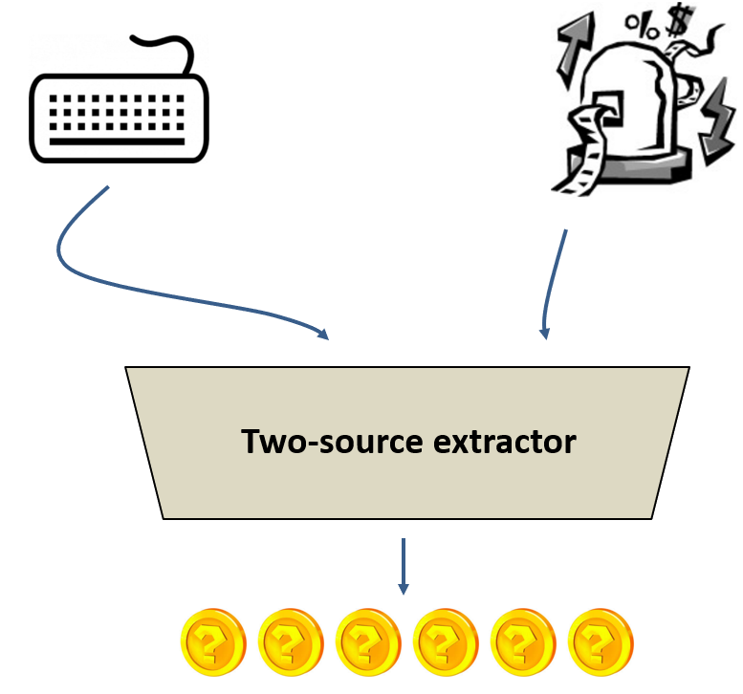
How random is a source? [Chor-Goldreich’88]
A random variable $X$ is a $k$-source if $∀x Pr\left[X=x\right]≤2^{−k}$.
Two-source extractors [Chor-Goldreich’88]
$Ext:{\left\{0,1\right\}}^{n}×{\left\{0,1\right\}}^{n}→\left\{0,1\right\}$ is a two-source extractor for min-entropy $k$ if for any pair of independent $k$-sources $X,Y$, $Ext\left(X,Y\right)$ has bias $≤0.1$.
Two simple facts
* There is no $1$-source extractor (even) for $k = n−1$.
* There exists a 2-source extractor for $k=\log_{2}{n}+O\left(1\right)$.

Slide 4
Explicit constructions of 2-source extractors
[Chor-Goldreich’88], [Raz’05], [Bourgain’05], [BenSasson-RonZewi’11].
Unfortunately, all require min-entropy $\sim n/2$ from at least one of the sources.
Much more success for $t≥3$ sources and 2-source dispersers
[Barak-Impagliazzo-Wigderson’04], [Barak-Kindler-Sudakov-Wigderson’05], [Raz’05], [Rao’06], [Barak-Rao-Shaltiel-Wigderson’06], [Li’11], [Li’13], [Li’15], [C’15], [C’16].
* 3-source extractors for min-entropy ${\left(\log{n}\right)}^{O\left(1\right)}$ [Li’15].
* 2-source dispersers for min-entropy ${\left(\log{n}\right)}^{O\left(1\right)}$ [C’16].
Back to 2-source extractors
A 2-source extractor for min-entropy ${\left(\log{n}\right)}^{O\left(1\right)}$ [Chattopadhyay-Zuckerman’16].
Can we get all the way down to logarithmic min-entropy?

Slide 5
Extractors for logarithmic min-entropy
[C-Schulman’16], [Chattopadhyay-Li’16], [C’16], [BenAroya-Doron-TaShma’17].
Accumulating to a 2-source extractor for min-entropy $\log\left(n\right)⋅2^{\sqrt{\log{\log{n}}}}$.
Result 1
We construct a 2-source extractor for min-entropy
$$k=\tilde{O}\left(\log{n}\right)=\log{n}⋅{\left(\log{\log{n}}\right)}^{O\left(1\right)}$$
* Li independently obtained $k=O\left(\log{n}⋅\log{\log{n}}\right)$.
Result 2
For any $t≥4$ there exists an $\exp\left(n\right)$-time $t$-source extractor for min-entropy
$$\left(\frac{1}{t−1}+o\left(1\right)\right)\log_{2}{n}$$
$$k=$$

Slide 6
Show me the construction!

Slide 7
Challenge-Response Mechanism
Condensers
Codes
Two-Source Dispersers
2.5-Source Extractors
Ramsey Graphs
Seeded Extractors
Alternating Extraction
Correlation Breakers
Two-Source Extractors
Mergers
Expanders
The Flip-Flop Primitive
Non-Malleable Extractors
Privacy Amplification Protocols
Independence Preserving Mergers

Slide 8
Mergers [TaShma’96]
$$Y_{1}$$
☺
☺
$$X$$
$$Y_{r}$$

Slide 9
Independence-Preserving Mergers [C-Schulman’16]
$$Y_{1}$$
☺
☺
$$X$$
$$Y_{r}$$
$$Y_{1}^{′}$$
$$X′$$
$$Y_{r}^{′}$$

Slide 10
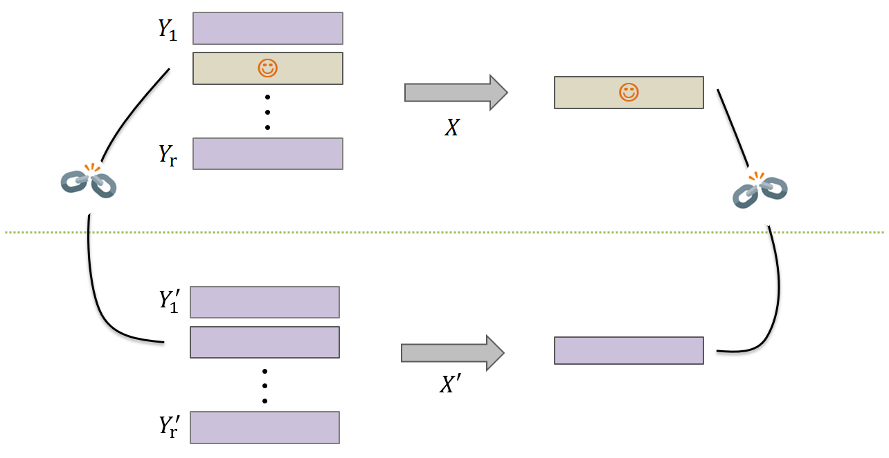
Independence-Preserving Mergers [C-Schulman’16]
* The goal is to minimize $X$’s min-entropy, $k$, as a function of $r,1/ε$.
* Hopefully, achieving $k=O\left(\log\left(r/ε\right)\right)$.
Main technical contribution
$k={\left(\log{r}\right)}^{O\left(1\right)}⋅\log\left(1/ε\right)$.
We construct an IPM for

Slide 11
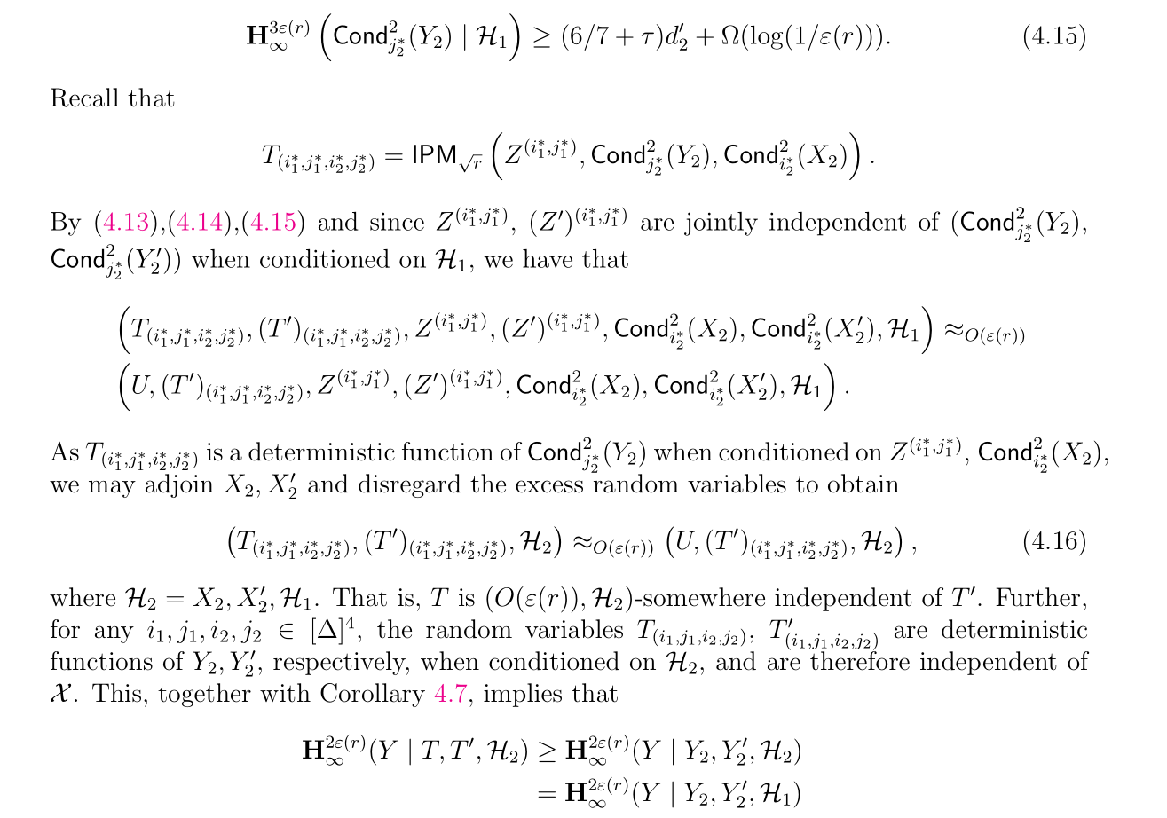
The IPM Construction

Slide 12
Which two rows to take?
$$Δ=O\left(1\right)$$
☺
$$Δ=O\left(1\right)$$
Not a 0.9 rate
Length $k$
☺
☺
Min-entropy $0.9k$
☺
☺
☺
☺
I ran out of sources…
$$\sqrt{r}$$
IPM
$$\sqrt{r}$$
$$\sqrt{r}$$
IPM
☺
IPM
$$r$$
☺
$$\sqrt{r}$$
$$\sqrt{r}$$
$$\sqrt{r}$$
$$\sqrt{r}$$
IPM
$$\sqrt{r}$$

Slide 13
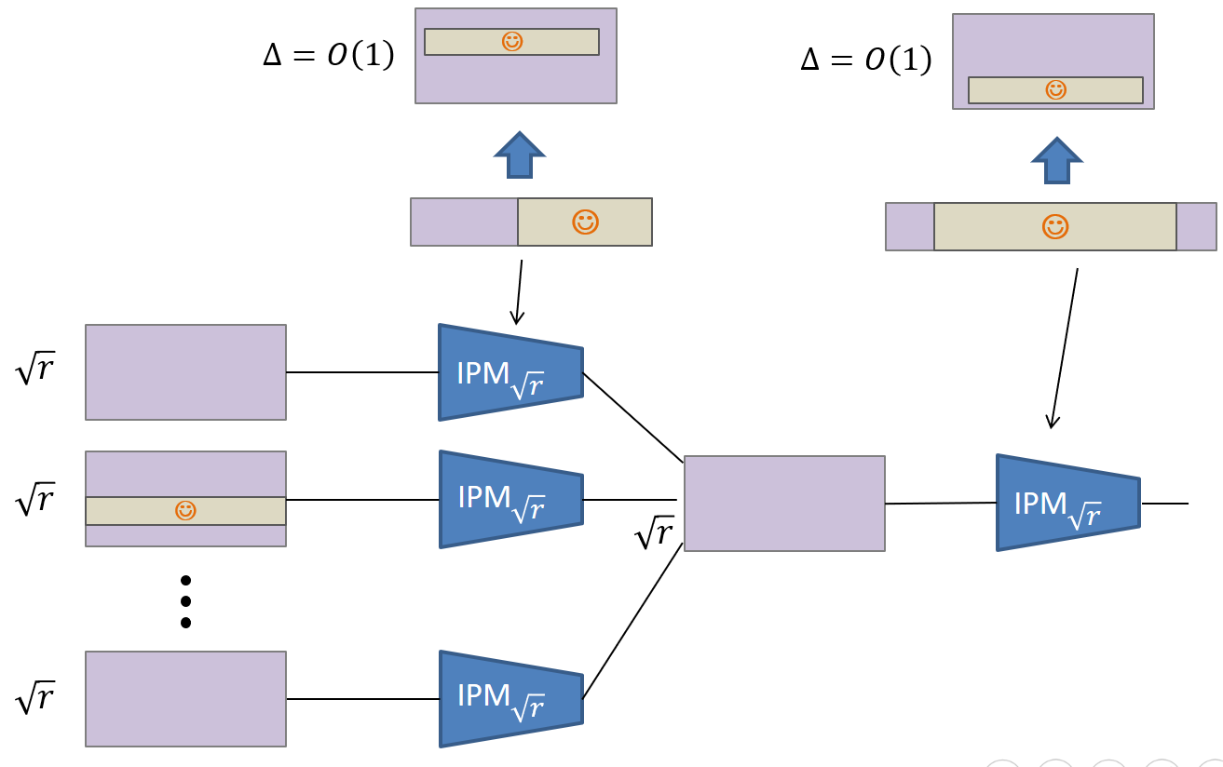
I ran out of sources…
☺
$$(1,1)$$
$$(1,2)$$
IPM
$$Δ^{2}$$
Not all $Δ^{2}$ rows are uniform
$$k\left(r\right)=c⋅k\left(\sqrt{r}\right)+Δ^{2}\log\left(1/ε\right)$$
$$k\left(r\right)={\left(\log{r}\right)}^{\log{c}}⋅Δ^{2}\log\left(1/ε\right)$$
$$(Δ,Δ)$$

Slide 14
Summary
* We construct a 2-source extractor for min-entropy $k=\tilde{O}\left(\log{n}\right)$.
* Main technical contribution is an improved IPM construction.
* We obtain a 4-source exponential-time extractor for $k=\left(\frac{1}{3}+o\left(1\right)\right)\log{n}$.
Open Problems
* Dah! Construct a 2-source extractor for min-entropy $O\left(\log{n}\right)$.
* Even a disperser or a 3-source extractor for such min-entropy.
* Optimal exponential-time 2-source extractors.
* Simplify
* More applications of the techniques and results.
Thanks!

