Slide 1
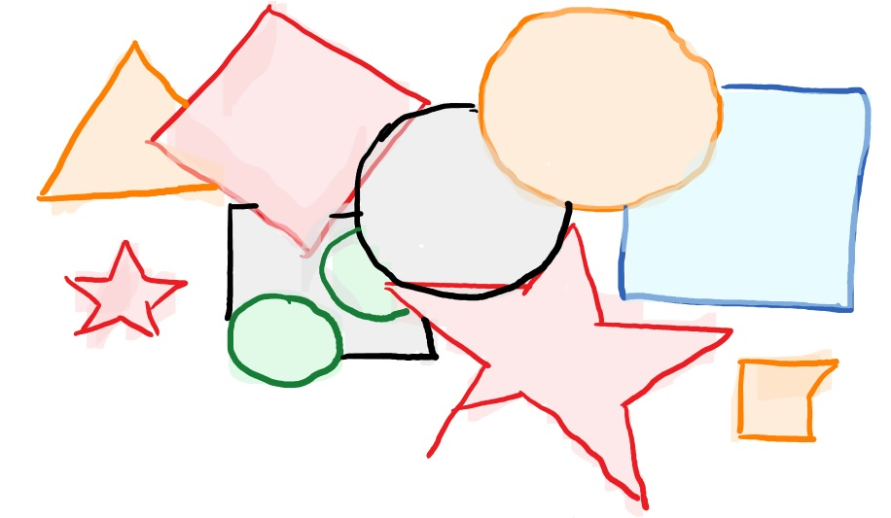
Quantum-proof extractors
Thomas Vidick
California Institute of Technology
Notes:
Motivation, examples, definitions (quantum side information), then results/open questions, sample proof of security: techniques, and conclude with more open questions.
This is a teaser that we really don’t know much, so look, all your fancy techniques, can they work in this setting. And not only just for the sake of challenging you, but generally, as an investigation into quantum information theory.

Slide 2

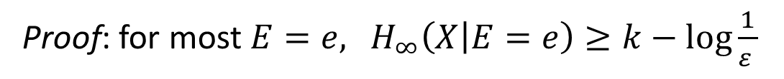

Recall privacy amplification
$$H_{∞}\left(X|E\right)≥k$$
public
Goal: convert weak shared secret X to uniform secret.
Correct by strong extractor definition
Pick
Y
$$Ext(X,Y)$$
Proof: for most $E=e,$ $H_{∞}\left(X | E=e\right)≥k−log\frac{1}{ε }$
Unbounded passive adversary. What if $E$ is quantum?
Notes:
Where does it come from, and how do we know it satisfies the entropy guarantee

Slide 3


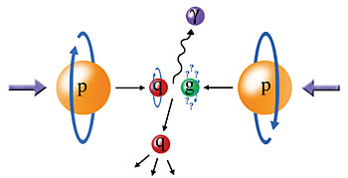



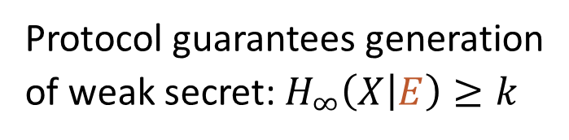


Sources of entropy $X$
Physical source of randomness: “quantum fluctuations”
Cryptography: $X$ comes from weak key exchange protocol
Ex: quantum key distribution
Randomness certification/expansion
Protocol guarantees generation
of weak secret: $H_{∞}\left(X | E\right)≥k$
meas.
meas.
Quantum side information! !
$0$101…
$$0101…$$
Do strong extractors extract uniform bits
from $X$ s.t. $H_{∞}\left(X | E\right)≥k$, for $E$ quantum?
Notes:
You can apply the same privacy amplification protocol, but then the question is whether it works.
This is the main motivation for q-proof extractors. There are connections to information theory, the most basic one is “how much information is in a quantum state, and the topic of quantum random access codes that I’ll talk about next. There are no connections with combinatorics but there are connections with functional analysis.

Slide 4
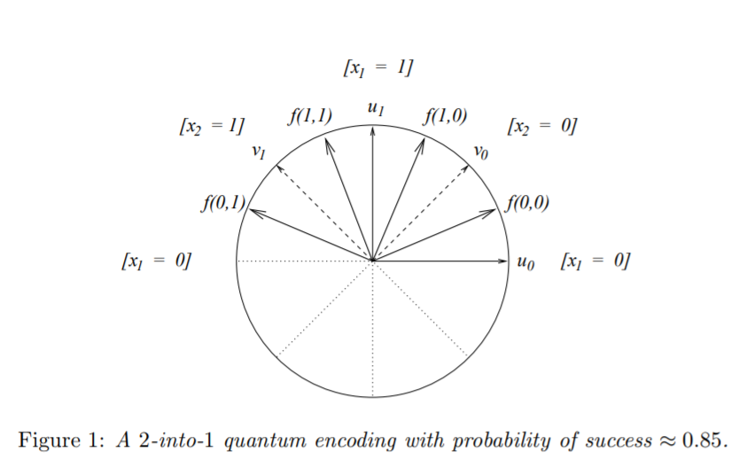

Example: indexing extractor
2-bit source $X=\left(x_{1},x_{2}\right),$ seed $Y∈\{1,2\}$, $Ext \left(X,Y\right)=X_{Y}$
Bounded storage model: $E$ = 1 bit/1 qubit
Classical: $E=x_{1}$gives advantage $\frac{1}{2}$
Quantum: can get
advantage $\frac{\sqrt{2}}{2}≈0.85$
[ANTV’98]
Does not generalize: no asymptotic quantum advantage
for random access codes
Notes:
More guessing strategies available to adversary, can make a difference. Same definition. Makes it trivial that weak extractors are quantum secure, because adversary’s measurement could have been made before
Indeed, one qubit does not hold more information than one bit. So, the difference is only when we get the seed, and we make an adaptive measurement.
The idea is that there is a bit more space on this sphere

Slide 5
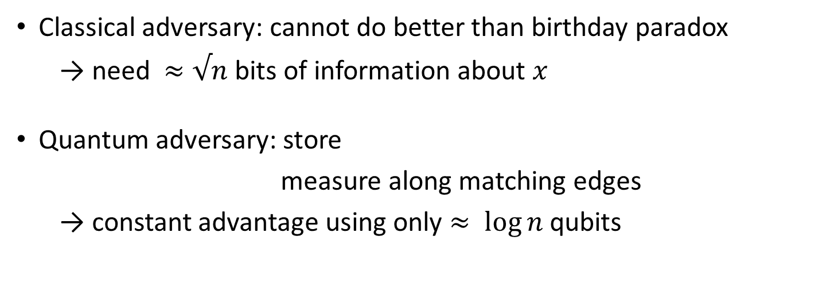
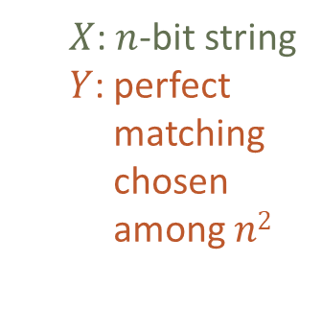
Example: perfect matching extractor
[GKKRW’07]
$$Ext: {\left\{0,1\right\}}^{n}×{\left\{0,1\right\}}^{2log n}→ {\left\{0,1\right\}}^{n/2}$$
$X$: $n$-bit string
$Y$: perfect
matching
chosen
among $n2$
x₁
x₂
x₃
x₄
Ext
x_{n-1}
x_{n}
Classical adversary: cannot do better than birthday paradox
  → need $≈√n$bits of information about $x$
Quantum adversary: store
measure along matching edges
→ constant advantage using only $≈ log⁡n$ qubits
Notes:
The measurement depends on the seed.
This example sounds dramatic when we formulate it in the bounded storage model, but if you think about it, this is a very bad extractor. It only extracts from sources that are very close to full entropy. So in the quantum case you need to be much closer to full.
Main message is that quantum state cannot store more information, but you can look at it in many different ways. This is what makes the question of quantum extractors so fascinating.
Ok so now let me tell you a little more about the model. This was all in the bounded storage model, but in general we have no bound on the size of the side information, so what is the proper way to quantify it.

Slide 6
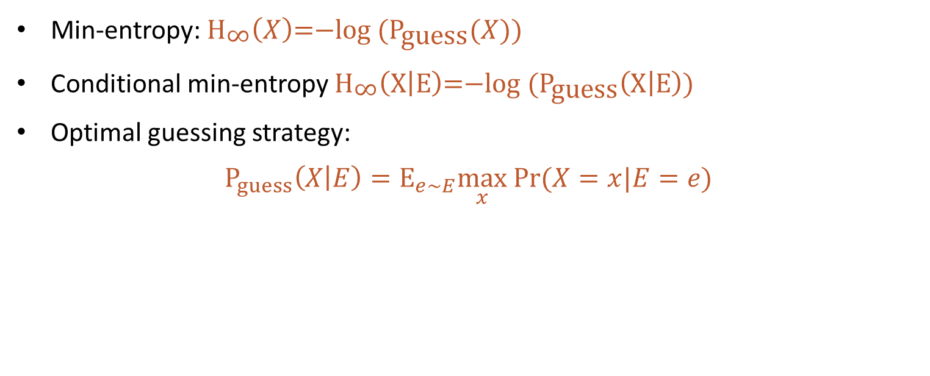



Conditional min-entropy
$$Pr⁡(X=x)$$
$$2^{−H_{∞}(X)}$$
$$x$$
Min-entropy: ${{\text{H}}_{\text{∞}}\left(X\right)\text{=−}\text{log}\text{ (}\text{P}}_{\text{guess}}(X)\text{)}$
Conditional min-entropy ${{\text{H}}_{\text{∞}}\left(\text{X} | \text{E}\right)\text{=−}\text{log}\text{ (}\text{P}}_{\text{guess}}\left(\text{X} | \text{E}\right)\text{)}$
Optimal guessing strategy:
$P_{guess}\left(X | E\right)=E_{e∼E}\max_{x} Pr(X=x|E=e)$
Notes:
First remember the classical case.
There is a nice operational interpretation as the maximum guessing probability. What is nice is that it immediately gives rise to the right definition of conditional entropy.
And here P_guess is operational, so if you remember this definition it tells you where to put the expectation.

Slide 7




Quantum conditional min-entropy
$$Pr⁡(X=x)$$
$$2^{−H_{∞}(X)}$$
$$x$$
Quantum min-entropy: ${{\text{H}}_{\text{∞}}\left(X\right)\text{=−}\text{log}\text{ (}\text{P}}_{\text{guess}}(X)\text{)}$
Quantum conditional min-entropy ${{\text{H}}_{\text{∞}}\left(\text{X} | \text{E}\right)\text{=−}\text{log}\text{ (}\text{P}}_{\text{guess}}\left(\text{X} | \text{E}\right)\text{)}$
Optimal guessing strategy:
$P_{guess}\left(X | E\right)={\sup_{ℳ}E}_{e∼ℳ(E)}\max_{x} Pr(X=x|ℳ(E)=e)$
Any weak extractor is automatically quantum-proof:
for fixed $ℳ$, $H_{∞}\left(X | ℳ(E)\right)≥H_{∞}(X|E)$
Notes:
The nice thing is that if I use the operational definition, I can make exactly the same definition. First, without side information, well, there is nothing quantum, so nothing changes. Then, when the SI is quantum, I can still write the definition in the same way, but I have to clarify what I mean by it.
More guessing strategies available to adversary, can make a difference. Same definition. Makes it trivial that weak extractors are quantum secure, because adversary’s measurement could have been made before
The difficulty is for strong extractor, it’s like in the perfect matching thing, the measurement you make depends on the seed, so you can’t push it back and say let’s fix the side information, because you can’t fix the measurement. And so then as soon as we allow the seed we’re totally stuck.

Slide 8
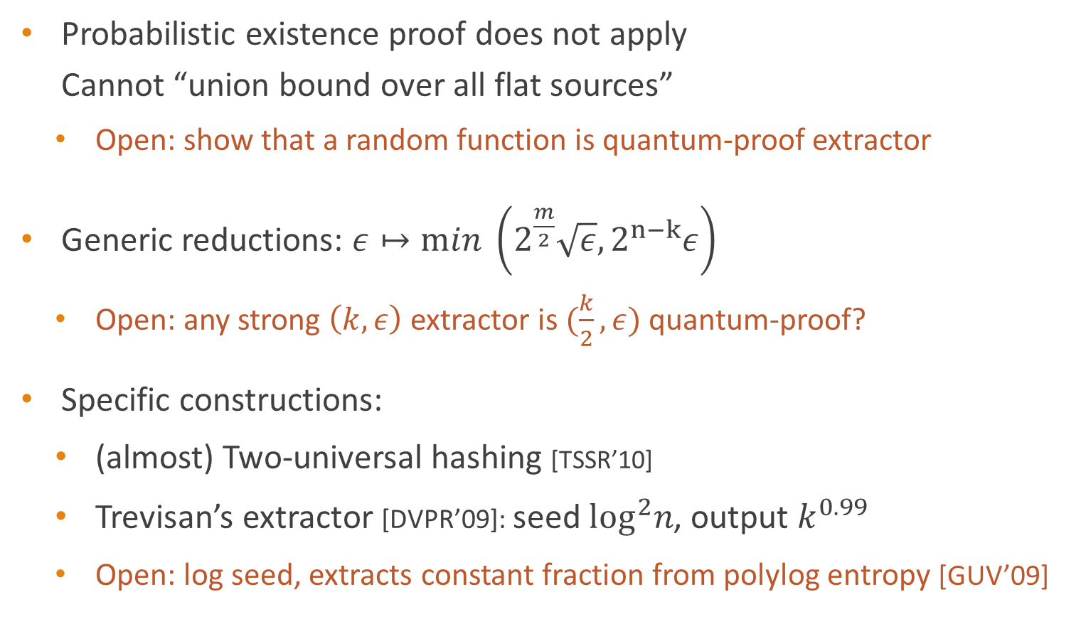
Strong quantum-proof extractors
Probabilistic existence proof does not apply
Cannot “union bound over all flat sources”
  Open: show that a random function is quantum-proof extractor
Generic reductions: $ε↦min \left(2^{\frac{m}{2}}\sqrt{ε}, 2^{n−k}ε\right)$
  Open: any strong $\left(k,ε\right)$ extractor is $(\frac{k}{2},ε)$ quantum-proof?
Specific constructions:
  (almost) Two-universal hashing [TSSR’10]
  Trevisan’s extractor [DVPR’09]: seed $\log^{2}n$, output $k^{0.99}$
  Open: log seed, extracts constant fraction from polylog entropy [GUV’09]
Notes:
This is open, even with weak parameters. Well, up to some loss, so there are some generic reductions, basically based on Cauchy-Schwarz, they’re not hard, but they’re not very good either.
Generic reduction is good for $m=1$ or very large $k$
Also open if you can somehow extract ½ as many bits.

Slide 9
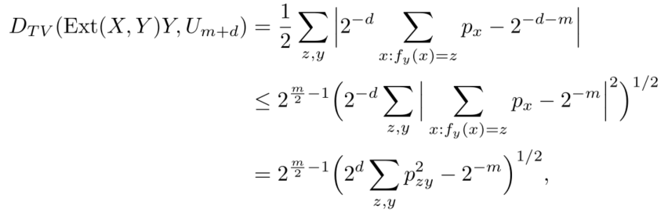

Case study: leftover hashing
$Ext:{\left\{0,1\right\}}^{n}×{\left\{0,1\right\}}^{d}→{\left\{0,1\right\}}^{m}$, $Ext\left(x,y\right)=f_{y}\left(x\right)$,
2-wise universal:${x≠x}^{′} ⟹ \underset{y}{Pr}\left(f_{y}\left(x\right)=f_{y}\left(x^{′}\right)\right)=2^{−2m}$
Key step:
Cauchy-Schwarz inequality bounds TV distance by collision probability
Use 2-universal property to bound final expression by $2^{\frac{m−k}{2}−1}$
Notes:
This is the main quantum technique
The key point is that we related statistical distance to collision probability
Everyone has seen this but I wanted to show you how to complete the analysis in the quantum case, at least at some high level, because it’ll also let me introduce the one main technique that we have available to do proofs in this area.

Slide 10
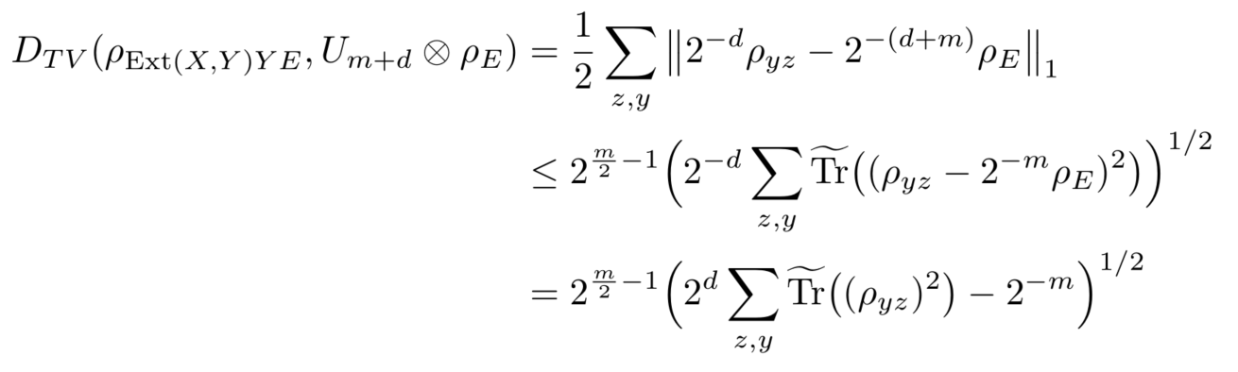

The pretty-good measurement
Key step:
Quantum side information: $p_{x}→ρ_{x}$ psd, $Tr\left(ρ_{x}\right)=p_{x}$
Notes:
This is the main quantum technique
PGM measures in ``orthonormalized’’ $\{|ψ_{x}⟩⟨ψ_{x}|\}$
→ Quadratically far from optimal
And you get exactly the same error bound.

Slide 11

The pretty-good measurement
Quantum side information: $p_{x}→ρ_{x}$ psd, $Tr\left(ρ_{x}\right)=p_{x}$
“Cauchy-Schwarz”: approximate $ℓ_{∞}$-guessing with $ℓ_{2}$-guessing
“Pretty-good measurement” uses measurement elements $\{M_{x}=ρ_{x}\}$
$ℓ_{∞}$-guess $x={argmax}_{x′} p\left(x′\right)$ → success $2^{−H_{∞}(X)}$
$ℓ_{2}$-guess $x∼p\left(x\right)$ → success $2^{−H_{2}(X)}≥2^{−H_{∞}(X)/2}$
Notes:
This is the main quantum technique
PGM measures in ``orthonormalized’’ $\{|ψ_{x}⟩⟨ψ_{x}|\}$
→ Quadratically far from optimal
And you get exactly the same error bound.

Slide 12
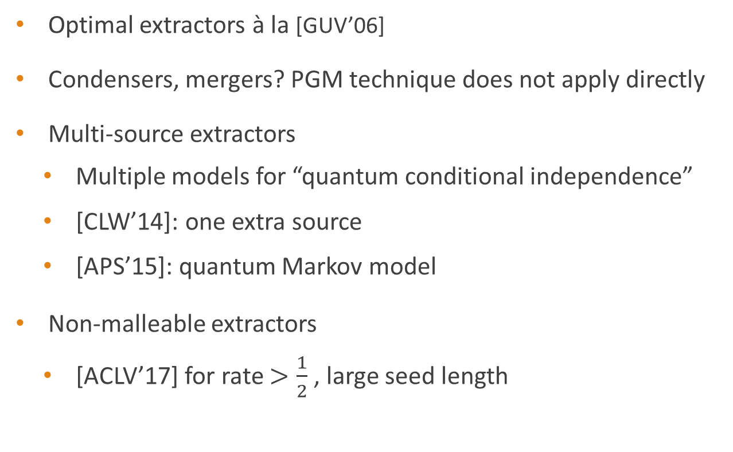
Some constructions with no quantum analogue
Optimal extractors à la [GUV’06]
Condensers, mergers? PGM technique does not apply directly
Multi-source extractors
  Multiple models for “quantum conditional independence”
  [CLW’14]: one extra source
  [APS’15]: quantum Markov model
Non-malleable extractors
  [ACLV’17] for rate $>\frac{1}{2}$ , large seed length

Slide 13



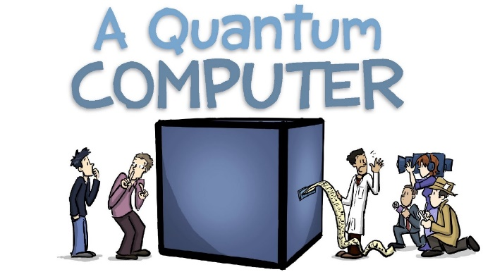
http://iqim.caltech.edu/outreach
Notes:
Bienvenue à tous. Ça me fait vraiment plaisir de parler ici. C’est à Paris que j’ai pour la première fois été exposé au calcul quantique, il y a 10 ans très exactement. Ce qui m’a immédiatement attiré a été l’idée que l’ordinateur quantique nous offre une nouvelle méthode d’approcher le monde physique. Le monde physique est quantique, et les lois du quantiques sont difficiles à comprendre. L’idée est donc d’en faire quelque chose, un ordinateur, et d’utiliser cet ordinateur comme un objectif, une lentille, pour observer le monde, comme cet œil qui reflète le ciel.
Depuis, beaucoup de progrès a été accompli, et en particulier des progrès expérimentaux. En 2007, on ne parlait pas d’ordinateurs quantiques, tout au plus on s’osait á espérer mettre en place un ou deux qubits. Depuis la situation a changé de manière dramatique, les ordinateurs sont construits, et cela donne une nouvelle tournure à mon histoire – c’est la parabole de l’homoncule. Maintenant que l’on a des ordinateurs, quantiques, qui nous aident à comprendre des phénomènes quantiques – mais comprend-on l’ordinateur lui-même? Si la mécanique quantique est si compliquée, et l’on prétend fabriquer nos outils de travail en se basant sur ces ‘règles, dans quelle mesure ces outils de travail sont-ils fiables?
C’est le thème général que j’aimerais aborder dans cet exposé, cette questions de comment faire pour réconcilier deux univers, l’univers quantique, univers complexe, contre-intuitif de l’infiniment petit, univers invisible, et le monde classique, qui est le monde de notre expérience la plus directe.
Avant tout ça je devrais tout de même commencer par vous introduire l’objet de cet exposé, ce mystérieux ordinateur quantique. En 2017 c’est une tâche facile, parce qu’on en parle, de l’ordinateur quantique, il fait régulièrement la une de la page science des grand journaux,
Je m’excuse d’avance pour les neologismes qui risquent fort de parsemer cet exposé

