Slide 1
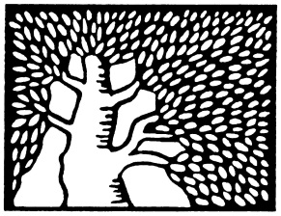
On Rigid Matrices and U-Polynomials
Noga Alon, Gil Cohen

Slide 2
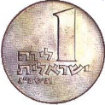
Matrix Rigidity
( )
( )
1
0
1
.
.
0
.
1
$$n−k$$
$$\frac{{\left(n−k\right)}^{2}}{\log{n}}$$
( )
[Valiant77] A matrix is (k,d)-rigid if decreasing its rank to k requires changing at least d entries in each row.
Best explicit construction
on average, over the rows.
$$\frac{n^{2}}{k}\log{\frac{n}{k}}$$

Slide 3
Motivation from Algebraic Circuit Complexity
Given an $n×n$ matrix M, how hard is it to compute the linear transformation x$→$Mx ?
Size $O\left(n^{2}\right)$, depth $O\left(\log{n}\right)$ always suffices.
Size $Ω\left(\frac{n^{2}}{\log{n}}\right)$ is typically necessary.
+
Open Problem. Efficiently construct a
matrix M that cannot be computed by
linear-size circuits.
+
+
+
+
Even Easier. and logarithmic-depth
simultaneously.
$$x_{1}$$
$$x_{2}$$
$$⋯$$
$$x_{n}$$

Slide 4
Motivation from Algebraic Circuit Complexity
Theorem [Valiant77]. If M is $\left(Ω\left(n\right),n^{Ω\left(1\right)}\right)$-rigid, then any logarithmic-depth circuit for computing M has size $Ω\left(n⋅\log{\log{n}}\right)$.
Fact. There exist $\left(Ω\left(n\right),Ω\left(\frac{n}{\log{n}}\right) \right)$-rigid matrices.
Attracted a lot of attention [Friedman93, Lokam95, Shokrollahi- SpielmanStemann97, KashinRazborov98, Lokam06, DeWolf06, AlonPanigrahy- Yekhanin09, KumarLokamPatankarSarma09, Dvir10, ServedioViola12] and many more related papers.
Barrier. Still stuck at $\left(Ω\left(n\right),Ω\left(1\right)\right)$.

Slide 5
Set Rigidity
[AlonPanigrahyYekhanin09] A set $S⊂{\left\{0,1\right\}}^{n}$ is (k,d)-rigid if for every dimension k subspace U, $\max_{s∈S} dist_{H}\left(s,U\right)≥d$.
Observation. (k,d)-rigid set $≡\text{(}\text{k}\text{,}\text{d}\text{)−}\text{rigid} \text{matrix}$.
Pre-[AlonPanigrahyYekhanin09] research focused on $n×n$ matrices, and explored tradeoffs between k,d.
[AlonPanigrahyYekhanin09] fix k=n/2 and try to get the set size m=m(n,d) as small as possible.
Sounds like a job for a pseudorandomnist!
Holy Grail. m=O(n)+poly(d).
[AlonPanigrahyYekhanin09] m=n$⋅$exp(d).

Slide 6
Contributions of this Work
2-Source Extractors
Small-Bias Sets
Rigid Sets
Codes
Seeded Extractors
Samplers
Expanders
Hash Functions

Slide 7
Contributions of this Work
PRG for U-Polynomials
2-Source Extractors
Small-Bias Sets
Rigid Sets
Codes
Seeded Extractors
Samplers
Expanders
Hash Functions

Slide 8
Contributions of this Work
PRG for U-Polynomials
2-Source Extractors
Small-Bias Sets
Rigid Sets
Codes
Seeded Extractors
Samplers
Expanders
Hash Functions

Slide 9
Contributions of this Work
PRG for U-Polynomials
2-Source Extractors
Small-Bias Sets
Rigid Sets
Codes
Seeded Extractors
Samplers
Expanders
Hash Functions

Slide 10
U-Polynomials
Definition. For a subspace U and a constant $ρ∈\left(0,1\right)$ define the polynomial $p_{U}:{\left\{±1\right\}}^{n}→ R$
$$p_{U}\left(x\right)=\sum_{u∈U}{ρ^{\left|u\right|}x_{u}}$$
($x_{1001}=x_{1}x_{4}$)
Example. $U=Span\left\{e_{1},e_{1}+e_{2}+e_{3} \right\}$
$$p_{U}\left(x\right)=1+ρx_{1}+ρ^{3}x_{1}x_{2}x_{3}+ρ^{2}x_{2}x_{3}$$
Normalize by the weight enumerator $\sum_{u∈U}{ρ^{\left|u\right|}}$.
Properties.
$p_{U}\left(x\right)∈\left(0,\right.\left.1\right]$.
W.h.p. over x, $p_{U}\left(x\right)≤exp\left(−n\right)$.

Slide 11
Theorem 1
Theorem 1.For every U,x
$dist\left(x,U\right)≥Ω\left(\log{\frac{1}{p_{U^{⊥}}\left(x\right)}}\right)$.
Claim. W.h.p, a random set $S⊂{\left\{0,1\right\}}^{n}$ of size O(n) has the following property:
$∀U{ ∃s∈S p}_{U}\left(s\right)≤exp\left(−n\right)$.

Slide 12
Fooling Polynomials
Degree 1 (Small-Bias Sets) [NaorNaor92, AlonGoldreichHastad- Peralta92, AlonBruckNaorNaorRoth92, BenAroyaTaShma09].
Degree d [LubyVelickovicWigderson93, Bogdanov05, BogdanovViola07, Lovett08, Viola09].
Sparse Polynomials [LubyVelickovicWigderson93, Viola06, Agrawal- Bhowmick10].
U-Polynomials [ThisWork12, YourWork13, … ☺].

Slide 13
Proof Idea
Min-distance is hard - shift to energy!
$$dist\left(x,U\right)=\min_{u∈U}{ \left|x+u\right|}$$

Slide 14
Proof Idea
Min-distance is hard - shift to energy!
$$dist\left(x,U\right)=\min_{u∈U}{ \left|x+u\right|}$$
$$dist\left(x,U\right)=\min_{u∈U}{ \left|x+u\right|}$$
$$energy_{U}\left(x\right)=\sum_{u∈U}{ρ^{\left|u+x\right|}}$$

Slide 15
Proof Idea
$$energy_{U}\left(x\right)=\sum_{u∈U}{ρ^{\left|u+x\right|}}$$
Step 1) Small $energy_{U}\left(x\right)$ implies large $dist\left(x,U\right)$ (depending on the “density” of U).
Step 2) Observe that $energy_{U}\left(x\right)$ is an application of the Fourier noise operator on U’s indicator.
Step 3) Compute the above operator and show it is related to $p_{U^{⊥}}\left(x\right)$ (using MacWilliams Indentity).

Slide 16
Rigid Sets from Small-Bias Sets
PRG for U-Polynomials
2-Source Extractors
Small-Bias Sets
Rigid Sets
Codes
Seeded Extractors
Samplers
Expanders
Hash Functions

Slide 17
Small-Bias Sets
Definition [NaorNaor92]. A sample space ${S⊂\left\{0,1\right\}}^{n}$ is called $ε$-biased if $∀x≠0$
$\left|\underset{s\sim S}{Pr}\left[\left\langle x,s\right\rangle =0\right]−\frac{1}{2}\right|≤ε$.
Close-to-optimal explicit constructions (poly in $n,1/ε$) [NaorNaor92, AlonGoldreichHastadPeralta92, AlonBruckNaorNaorRoth92, BenAroyaTaShma09].
Many applications. [NaorNaor92, AlonRoichman94, BenSassonSudan- VadhanWigderson03, Raz05, ViolaWigderson08, Viola09, ArvindSrinivasan10, DeEtesamiTrevisanTulsiani10, GopalanMekaReingoldTrevisanVadhan12, JafargholiViola13].

Slide 18
(Large..) Small-Bias Sets are Rigid
Theorem 2. Every $ε$-biased set is $\left(n/2,Ω\left(\log{1/ε}\right) \right)$-rigid.
Idea. Shift from distance to membership.

Slide 19
(Large..) Small-Bias Sets are Rigid
Theorem 2. Every $ε$-biased set is $\left(n/2,Ω\left(\log{1/ε}\right) \right)$-rigid.
Idea. Shift from distance to membership.
Lemma [AlonPanigrahyYekhanin09]. The d-neighborhood of any subspace with dimension n/2 can be covered by exp(d) subspaces of dimension 3n/4.

Slide 20
(Large..) Small-Bias Sets are Rigid
Definition [NaorNaor92]. A sample space ${S⊂\left\{0,1\right\}}^{n}$ is called $ε$-biased if $∀x≠0$
$\left|\underset{s\sim S}{Pr}\left[\left\langle x,s\right\rangle =0\right]−\frac{1}{2}\right|≤ε$.
Lemma.
Equivalently. A sample space ${S⊂\left\{0,1\right\}}^{n}$ is called $ε$-biased if for any subspace U with co-dim 1
$$\left|\frac{\left|S∩U\right|}{\left|S\right|}−\frac{\left|U\right|}{2^{n} }\right|≤ε$$
A similar lemma was proven (differently) in [ArvindSrinivasan10].

Slide 21
A Proof of the Lemma
Theorem [AlonChung88]. Let G be a d-regular on N vertices with spectral gap $1−λ$ . Then, for any subset U of the vertices,
$$\left|S\right|$$
$$ε\left|S\right|\left|U\right|$$
$\left|e\left(U\right)−\frac{1}{2 }d\left|U\right|⋅\frac{\left|U\right|}{N}\right|≤\frac{1}{2}λd\left|U\right|$.
Theorem [AlonRoichman94]. Let $S⊂{\left\{0,1\right\}}^{n}$ be an $ε$-biased set. Define the graph G on ${\left\{0,1\right\}}^{n}$ with an edge {u,v} iff $u+v∈S$. Then, G has spectral gap $1−ε$.

Slide 22
A Proof of the Lemma
Proof. The degree of u in the graph induced by U is
Proof.
$\left|s∈S:u+s∈U\right|=\left|s∈S:s∈U\right|=\left|S∩U\right|$.
Thus, $\left|e\left(U\right)\right|=\frac{1}{2}\left|U\right|\left|S∩U\right|$.
Apply [AlonChung88] + [AlonRoichman94].

Slide 23
Rigid Sets from
Unbalanced Expanders
PRG for U-Polynomials
2-Source Extractors
Small-Bias Sets
Rigid Sets
Codes
Seeded Extractors
Samplers
Expanders
Hash Functions

Slide 24
Unbalanced Expanders
$$m$$
$$n$$
$$≥\left(1/3\right)ds$$
unique neighbors
$$d$$
$$≥\left(2/3\right)ds$$
$$s≤t$$
Best construction [GuruswamiUmansVadhan06] is close to optimal. Many applications [Upfal-Wigderson87, BenSassonWigderson01, AlekhnovichRazborov01, BuhrmanMiltersenRadhakrishnanVenkatesh02, Alekhnovich- BenSassonRazborovWigderson04, GuruswamiLeeRazborov07, BenAroyaCohen12].

Slide 25
Rigid Sets from Unbalanced Expanders
$$m$$
$$n$$
${\left(c_{v}\right)}_{i}=1$ iff $\left\{v,i\right\}∈E$.
0
v
$$C=\left\{c_{v}:v∈\left[m\right]\right\}$$
1
0
Theorem 3. If $\sum_{i=0}^{t/2}{\left(\begin{matrix}m \\ i\end{matrix}\right)>2^{k}}$ then C is (k,d/4)-rigid.
Using an optimal unbalanced expander yields a (k,d)-rigid set with size $n⋅exp\left(\frac{k}{n}⋅d\right)$.

Slide 26
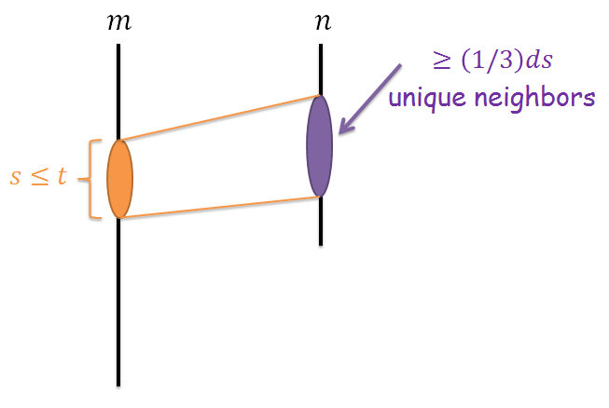
Rigid Sets from Unbalanced Expanders
$$c_{1}$$
$U_{1}=\left\{u_{i}\right\}$ has size m.
$$u_{2}$$
$$u_{1}$$
$$c_{2}$$
$$u_{m}$$
$$u_{3}$$
$$c_{m}$$
$$c_{3}$$
$$d/4$$
$$\frac{1}{3}d⋅2≤\left|c_{i}+c_{j}\right|≤\left|c_{i}+u_{i}\right|+\left|c_{j}+u_{j}\right|+\left|u_{i}+u_{j}\right|≤2⋅\frac{d}{4}+0$$

Slide 27
Rigid Sets from Unbalanced Expanders
$$c_{1}$$
$U_{1}=\left\{u_{i}\right\}$ has size m.
$$u_{2}$$
$$u_{1}$$
What about $U_{2}=\left\{u_{i}+u_{j}\right\}$?
$$c_{2}$$
$$\left|U_{2}\right|=\left(\begin{matrix}m \\ 2\end{matrix}\right)$$
$$u_{m}$$
$$u_{3}$$
$$c_{m}$$
$$c_{3}$$
$$d/4$$
$$\frac{1}{3}d⋅4≤\left|c_{i_{1}}+⋯+c_{i_{4}}\right|≤\left|c_{i_{1}}+u_{i_{1}}\right|+⋯+\left|c_{i_{4}}+u_{i_{4}}\right|+\left|u_{i_{1}}+⋯+u_{i_{4}}\right|≤4⋅\frac{d}{4}+0$$

Slide 28
Rigid Sets from Unbalanced Expanders
$$c_{1}$$
$U_{1}=\left\{u_{i}\right\}$ has size m.
$$u_{2}$$
$$u_{1}$$
What about $U_{2}=\left\{u_{i}+u_{j}\right\}$?
$$c_{2}$$
$$\left|U_{2}\right|=\left(\begin{matrix}m \\ 2\end{matrix}\right)$$
.
$$u_{m}$$
.
.
$$u_{3}$$
$$c_{m}$$
$$\left|U_{t/2}\right|=\left(\begin{matrix}m \\ t/2\end{matrix}\right)$$
$$c_{3}$$
$$d/4$$
$$U_{i}∩U_{j}=∅$$
$$\left|U_{1}∪⋯∪U_{t/2}\right|=\sum_{i=0}^{t/2}{\left(\begin{matrix}m \\ i\end{matrix}\right)>2^{k}}=\left|U\right|$$

Slide 29
The Remote Set Problem [AlonPanigrahyYekhanin09, ArvindSrinivasan10]
Is the rigidity problem easier given a (basis for a) subspace?
Not really! A log(n) barrier.
Related to the Nearest Codeword Problem [BermanKarpinski02, FeigeMicciancio02, Alekhnovich03, AroraBabaiStern- Sweedyk03, AlonPanigrahyYekhanin09].

Slide 30
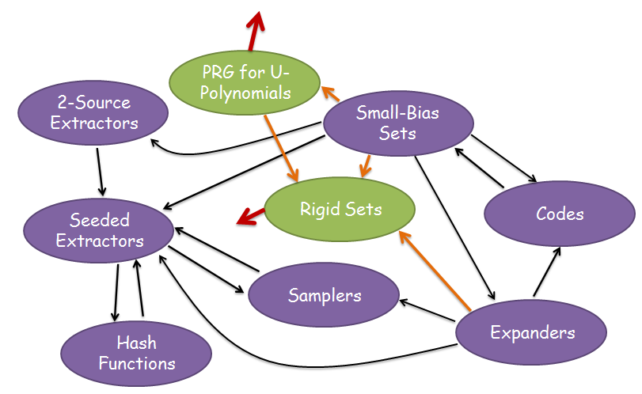
Open Problems
1) Construct a rigid set with size O(n)+poly(d).
2) Even with size n$⋅$exp(o(d)).
3)
4) A better algorithm for the Remote Set Problem.
5) Is it at all easier than rigidity?
6) New approach for linear circuit lower bounds.

Slide 31
Thank you
for your attention!

