Slide 1
Local correlation breakers and applications
Gil Cohen

Slide 2
Breaking correlations
The “breaking pairwise correlations” problem:
000011000000011
X
Y
X
f(X,Y)

Slide 3
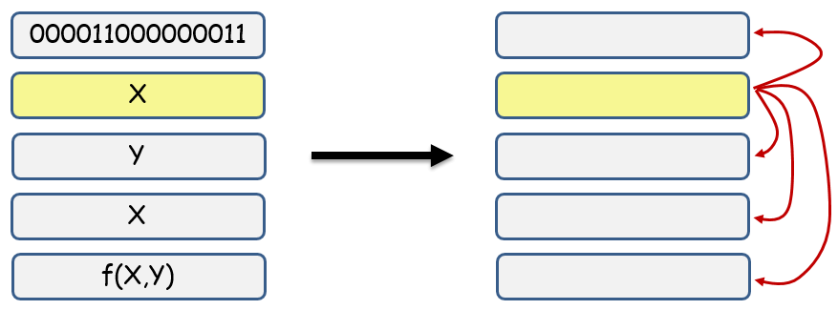
Breaking correlations
The “breaking pairwise correlations” problem:
Given random variables $X_{1},…,X_{r}$, compute random variables $Y_{1},…,Y_{r}$ s.t. if $X_{i}$ is uniform then $Y_{i}$ is uniform even given any other $Y_{j}$.
* A strengthening of an object used in [Li13].
* More generally, breaking $t$-wise correlations. Extreme case $t=r$.
* Cannot be done deterministically. Yet, for applications in mind we do not have truly random bits...
Def [ChorGoldreich88]. A random variable X, that is uniformly distributed over some set $T⊆{\left\{0,1\right\}}^{n}$ with size $\left|T\right|=2^{k}$ is called an $(n,k)$-source.
$${\left\{0,1\right\}}^{n}$$
$$T$$

Slide 4
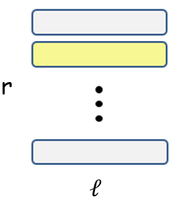
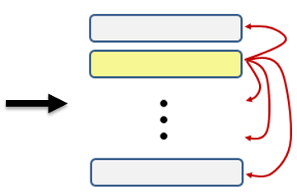
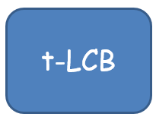
Local correlation breakers (LCBs)
Given $n,r,t$, minimize $k,ℓ$.
Main Theorem. There exists an explicit $t$-LCB with
$$k=poly\left(t,\log{r}\right)⋅\log{\log{n}}$$
$$ℓ=poly\left(t,\log{r}\right)⋅\log{n}$$

Slide 5
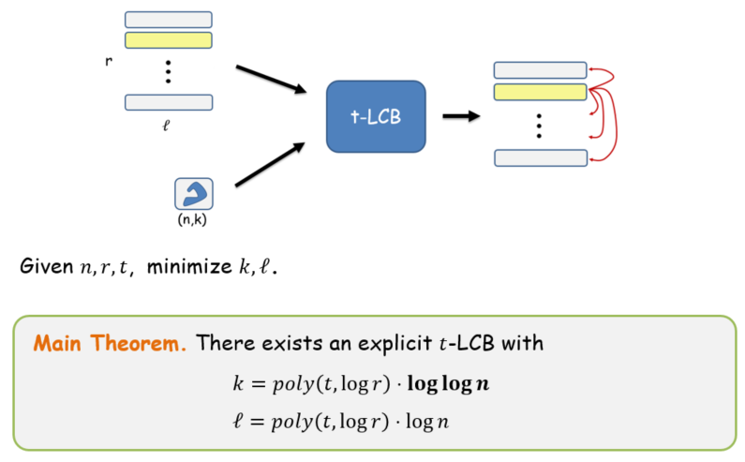
Roadmap
* Local correlation breakers
* Applications
* Mergers with weak-seeds
* 3-source extractors
* 2-source non-malleable extractors
* The LCB construction

Slide 6
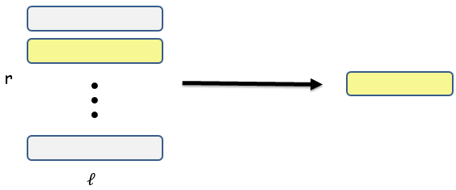
Mergers with weak-seeds
[Ta-Shma96, LuReingoldVadhanWigderson03, Raz05, DvirShpilka07, Zuckerman07, DvirRaz08, BarakRaoShaltielWigderson08, DvirWigderson11, DvirKoppartySarafSudan09]
The merging problem [Ta-Shma96]. Merge $X_{1},…,X_{r}$ into a single uniform random variable.
(n,k)
* Cannot be done deterministically.
* Explicit seeded-merger with$O\left(\log\left(rℓ\right)\right)$ random bits [DvirWigderson11].
* Explicit merger with weak-seeds* with $k=ℓ=poly\left(r,\log{n}\right)$ [BarakRaoShaltielWigderson08].
* Existential argument gives
$$k=\log{r}+\log{\log{n}}$$
$$ℓ=\log{n}$$

Slide 7
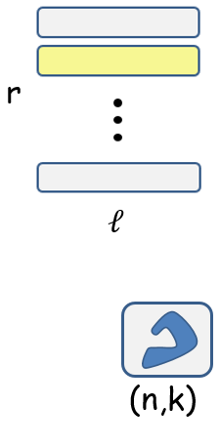
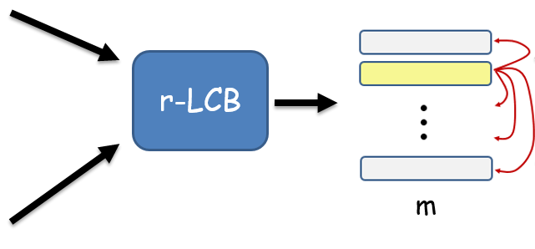
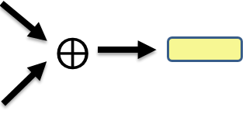
Mergers with weak-seeds via LCBs
Theorem. There exists an explicit merger with weak-seeds for
$$k=\tilde{O}\left(r\right)⋅\log{\log{n}}$$
$$ℓ=\tilde{O}\left(r^{2}\right)⋅\log{n}$$

Slide 8
Roadmap
* Local correlation breakers
* Applications
* Mergers with weak-seeds
* 3-source extractors
* 2-source non-malleable extractors
* The LCB construction

Slide 9
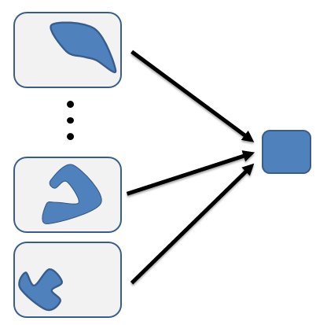
multi-source extractors
[ChorGoldreich88, BarakImpagliazzoWigderson06, Bourgain05, Raz05, BarakKindlerShaltielSudakovWigderson05, Rao09, Li11, Li13, Li15]
* Existential argument requires 2 n-bit sources with entropy $log n$.
* Explicit 2-source extractors:
$0.49n, 0.49n$ [Bourgain05].
$0.51n, \log{n}$ [Raz05].
* Explicit 3-source extractors:
$δn, \log{n}, \log{n}$ [Raz05].
+ lower exponent
(12 -> 5 I think..)
$\log^{12}n, \log^{12}{n}, \log^{12}{n}$ [Li15].
Theorem. $∀δ$ there exists an explicit 3-source extractor for entropies
$$k_{1}=δn$$
$$k_{2}=poly\left(1/δ\right)⋅log⁡n$$
$$k_{3}=poly\left(1/δ\right)⋅log⁡\log{n}$$

Slide 10
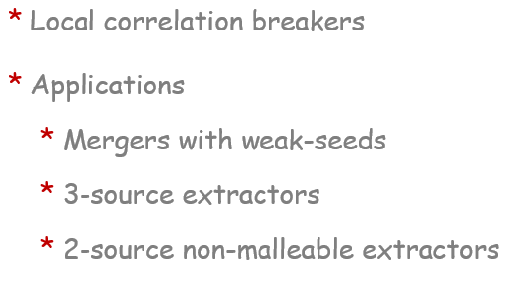
Roadmap
* The LCB construction
* Seeded extractors
* Two-steps look-ahead extractors
* The construction

Slide 11
Seeded extractors
[NisanZuckerman96, …, Trevisan01, RazReingoldVadhan99, TaShmaZuckermanSafra02,
ShaltielUmans01, GuruswamiUmansVadhan09, DvirKoppartySarafWigderson09, TaShmaUmans12]
Def. $E:{\left\{0,1\right\}}^{n}×{\left\{0,1\right\}}^{d}→{\left\{0,1\right\}}^{m}$ is a $k$-seeded extractor if for any $(n,k)$-source X and an independent seed S, E(X,S) is uniform.
* E is called strong if E(X,S) is uniform for almost all fixings S=s.
* Explicit constructions for any $n,k$ with $d=O(\log{n})$ and $m=0.9k$.
* Thou shalt have enough entropy in the source.
* Thou shalt use a uniform seed.
* Thou shalt not use correlated source and seed.

Slide 12
Hierarchy of independence
A
B
W₁
W₂
W_{r}
Y

Slide 13
Hierarchy of independence
A
B
W₁
W₂
W_{r}
Y

Slide 14
Hierarchy of independence
A
B
W₁
* A of a uniform row is uniform.
W₂
W_{r}
Y

Slide 15
Hierarchy of independence
A
B
W₁
* A of a uniform row is uniform.
W₂
* B of a uniform row is uniform even given all A’s.
W_{r}
Y

Slide 16
2-steps look-ahead extractors
[DziembowskiPietrzak07, DodisWichs09]
Y
S
W
A = E(Y,S )
T = E(W,A)
B = E(Y,T)
LA(W,Y) = (A,B)

Slide 17
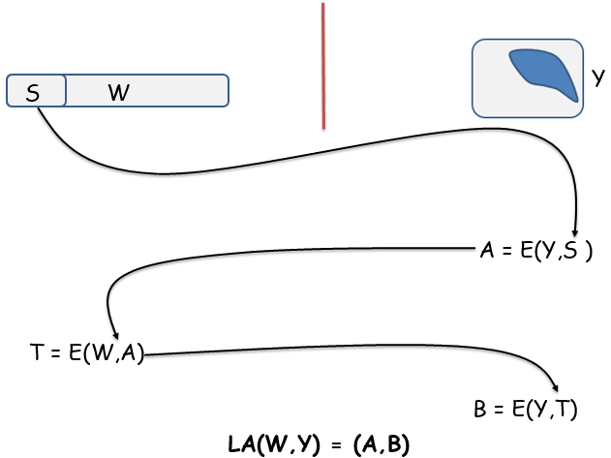
2-steps look-ahead extractors
[DziembowskiPietrzak07, DodisWichs09]
Theorem [DziembowskiPietrzak07]. Let W₁ be uniform and W₂ arbitrarily correlated with W₁. Let Y be an independent random variable. Let
(A₁, B₁) = LA(W₁,Y), (A₂, B₂) = LA(W₂,Y).
Then, B₁ is uniform (even) given W₁, W₂, A₁, A₂.

Slide 18
2-steps look-ahead extractors
[DziembowskiPietrzak07, DodisWichs09]
S₁
W₁
Y
S₂
W₂
A₁ = E(Y,S₁)
A₂ = E(Y,S₂)
T₁ = E(W₁,A₁)
T₂ = E(W₂,A₂)
B₁ = E(Y,T₁)
B₂ = E(Y,T₂)

Slide 19
2-steps look-ahead extractors
[DziembowskiPietrzak07, DodisWichs09]
Fixed
s₁
W₁
Y
S₂
W₂
A₁ = E(Y,s₁)
A₂ = E(Y,S₂)
T₁ = E(W₁,A₁)
T₂ = E(W₂,A₂)
B₁ = E(Y,T₁)
B₂ = E(Y,T₂)

Slide 20
2-steps look-ahead extractors
[DziembowskiPietrzak07, DodisWichs09]
Fixed
s₁
W₁
Y
Fixed
s₂
W₂
A₁ = E(Y,s₁)
A₂ = E(Y,s₂)
T₁ = E(W₁,A₁)
T₂ = E(W₂,A₂)
B₁ = E(Y,T₁)
B₂ = E(Y,T₂)

Slide 21
2-steps look-ahead extractors
[DziembowskiPietrzak07, DodisWichs09]
Fixed
s₁
W₁
Y
Fixed
s₂
W₂
Fixed
a₁ = E(Y,s₁)
A₂ = E(Y,s₂)
T₁ = E(W₁,a₁)
T₂ = E(W₂,A₂)
B₁ = E(Y,T₁)
B₂ = E(Y,T₂)

Slide 22
2-steps look-ahead extractors
[DziembowskiPietrzak07, DodisWichs09]
Fixed
s₁
W₁
Y
Fixed
s₂
W₂
Fixed
a₁ = E(Y,s₁)
Fixed
a₂ = E(Y,s₂)
T₁ = E(W₁,a₁)
T₂ = E(W₂,a₂)
B₁ = E(Y,T₁)
B₂ = E(Y,T₂)

Slide 23
2-steps look-ahead extractors
[DziembowskiPietrzak07, DodisWichs09]
Fixed
s₁
W₁
Fixed
Y
Fixed
Fixed
s₂
W₂
Fixed
a₁ = E(Y,s₁)
Fixed
Fixed
a₂ = E(Y,s₂)
t₁ = E(W₁,a₁)
T₂ = E(W₂,a₂)
B₁ = E(Y,t₁)
B₂ = E(Y,T₂)

Slide 24
Roadmap
* The LCB construction
* Seeded extractors
* Two-steps look-ahead extractors
* The construction

Slide 25
3-LCB for 3 rows
Y
A
B
A’
B’
W₁
X₁
W’₁ = E(X₁,B₁)
W₂
X₂
W’₂ = E(X₂,A₂)
W₃
X₃
W’₃ = E(X₃,A₃)
A’’
B’’
W’’₁ = E(X₁,A’₁)
Z₁ = E(X₁,A’’₁)
W’’₂ = E(X₂,B’₂)
Z₂ = E(X₂,A’’₂)
W’’₃ = E(X₃,A’₃)
Z₃ = E(X₃,B’’₃)
(A’_{1,} B’₁) = LA(W’₁,Y)
(A’’_{1,} B’’₁) = LA(W’’₁,Y)
(A_{1,} B₁) = LA(W₁,Y)
(A’_{2,} B’₂) = LA(W’₂,Y)
(A’’_{2,} B’’₂) = LA(W’’₂,Y)
(A_{2,} B₂) = LA(W₂,Y)
(A’_{3,} B’₃) = LA(W’₃,Y)
(A’’_{3,} B’’₃) = LA(W’’₃,Y)
(Z₁,Z₂,Z₃) = LCB((X₁,X₂,X₃),Y)
(A_{3,} B₃) = LA(W₃,Y)

Slide 26
3-LCB for 3 rows
Y
A
B
A’
B’
W₁
X₁
W’₁ = E(X₁,B₁)
W₂
X₂
W’₂ = E(X₂,A₂)
W₃
X₃
W’₃ = E(X₃,A₃)
A’’
B’’
W’’₁ = E(X₁,A’₁)
Z₁ = E(X₁,A’’₁)
W’’₂ = E(X₂,B’₂)
Z₂ = E(X₂,A’’₂)
W’’₃ = E(X₃,A’₃)
Z₃ = E(X₃,B’’₃)
(Z₁,Z₂,Z₃) = LCB((X₁,X₂,X₃),Y)

Slide 27
3-LCB for 3 rows
Y
A
B
A’
B’
W₁
X₁
W’₁ = E(X₁,B₁)
W₂
X₂
W’₂ = E(X₂,A₂)
W₃
X₃
W’₃ = E(X₃,A₃)
A’’
B’’
W’’₁ = E(X₁,A’₁)
Z₁ = E(X₁,A’’₁)
W’’₂ = E(X₂,B’₂)
Z₂ = E(X₂,A’’₂)
W’’₃ = E(X₃,A’₃)
Z₃ = E(X₃,B’’₃)
(Z₁,Z₂,Z₃) = LCB((X₁,X₂,X₃),Y)

Slide 28
3-LCB for 3 rows
Y
A
B
A’
B’
W₁
X₁
W’₁ = E(X₁,B₁)
W₂
X₂
W’₂ = E(X₂,A₂)
The assumption on the input is maintained
W₃
X₃
W’₃ = E(X₃,A₃)
A’’
B’’
W’’₁ = E(X₁,A’₁)
Z₁ = E(X₁,A’’₁)
W’’₂ = E(X₂,B’₂)
Z₂ = E(X₂,A’’₂)
W’’₃ = E(X₃,A’₃)
Z₃ = E(X₃,B’’₃)
(Z₁,Z₂,Z₃) = LCB((X₁,X₂,X₃),Y)

Slide 29
3-LCB for 3 rows
Y
A
B
A’
B’
W₁
X₁
W’₁ = E(X₁,B₁)
W₂
X₂
W’₂ = E(X₂,A₂)
W₃
X₃
W’₃ = E(X₃,A₃)
A’’
B’’
W’’₁ = E(X₁,A’₁)
Z₁ = E(X₁,A’’₁)
W’’₂ = E(X₂,B’₂)
Z₂ = E(X₂,A’’₂)
W’’₃ = E(X₃,A’₃)
Z₃ = E(X₃,B’’₃)
(Z₁,Z₂,Z₃) = LCB((X₁,X₂,X₃),Y)

Slide 30
3-LCB for 3 rows
Y
A
B
A’
B’
W₁
X₁
W’₁ = E(X₁,B₁)
W₂
X₂
W’₂ = E(X₂,A₂)
W₃
X₃
W’₃ = E(X₃,A₃)
A’’
B’’
W’’₁ = E(X₁,A’₁)
Z₁ = E(X₁,A’’₁)
W’’₂ = E(X₂,B’₂)
Z₂ = E(X₂,A’’₂)
W’’₃ = E(X₃,A’₃)
Z₃ = E(X₃,B’’₃)
The good row gains its independence once given the lead
(Z₁,Z₂,Z₃) = LCB((X₁,X₂,X₃),Y)

Slide 31
3-LCB for 3 rows
Y
A
B
A’
B’
W₁
X₁
W’₁ = E(X₁,B₁)
W₂
X₂
W’₂ = E(X₂,A₂)
W₃
X₃
W’₃ = E(X₃,A₃)
A’’
B’’
W’’₁ = E(X₁,A’₁)
Z₁ = E(X₁,A’’₁)
W’’₂ = E(X₂,B’₂)
Z₂ = E(X₂,A’’₂)
W’’₃ = E(X₃,A’₃)
Z₃ = E(X₃,B’’₃)
(Z₁,Z₂,Z₃) = LCB((X₁,X₂,X₃),Y)

Slide 32
3-LCB for 3 rows
Y
A
B
A’
B’
W₁
X₁
W’₁ = E(X₁,B₁)
W₂
X₂
W’₂ = E(X₂,A₂)
W₃
X₃
W’₃ = E(X₃,A₃)
A’’
B’’
W’’₁ = E(X₁,A’₁)
Z₁ = E(X₁,A’’₁)
W’’₂ = E(X₂,B’₂)
Z₂ = E(X₂,A’’₂)
W’’₃ = E(X₃,A’₃)
Z₃ = E(X₃,B’’₃)
The independence is preserved when other rows are given the lead
(Z₁,Z₂,Z₃) = LCB((X₁,X₂,X₃),Y)

Slide 33
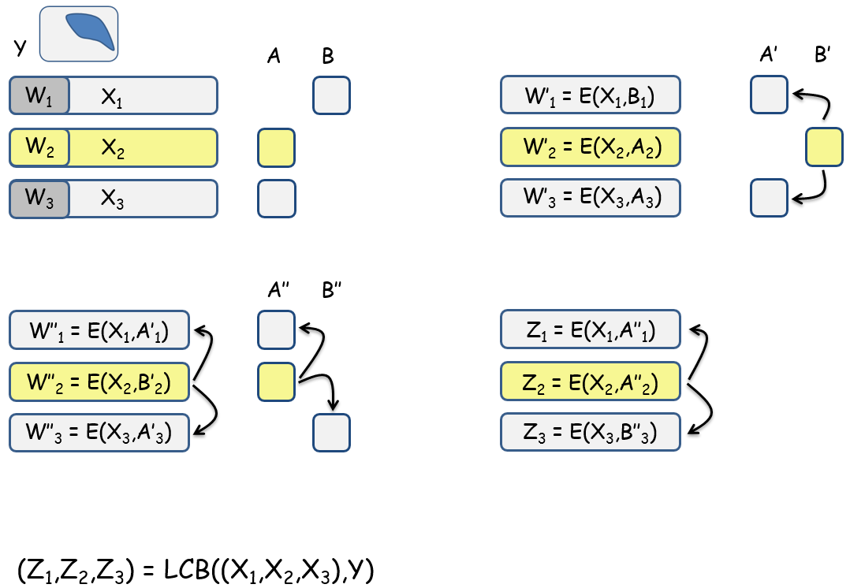
Where does the loglog(n) come from?
* W’s are seeds for the (n,k)-source Y, and so $|W|=O(log⁡n)$.
* X and W have the same length up to a $poly(r)$ factor, so $\left|X\right|=poly\left(r\right)⋅\log{n}$.
* A’s and B’s are seeds for X (and W), and so $\left|A\right|=\left|B\right|=\log\left(r⋅\log{n}\right)$.
* Y is used only for computing the A’s and B’s.

Slide 34
Reducing the number of rounds
2
…
B
4
1
A
B
5
6
7
A
A
3
B
8
9

Slide 35
Reducing the number of rounds
2
…
4
1
B
A
5
6
A
7
B
3
8
9
Use arbitrary cuts in a “flip-flop”.

Slide 36
Reducing the number of rounds
2
4
1
B
A
5
6
7
3
A
B
8
9
Use arbitrary cuts in a “flip-flop”.
Use a sequence of log(r) cuts such that for any two distinct vertices there is a cut that separates them.

Slide 37
Summary and problem problems
* We’ve introduced and constructed LCBs.
* Applications:
* Mergers with weak-seeds with double-logarithmic entropy.
* 3-source extractors with one double-logarithmic entropy source.
* 2-source non-malleable extractors.
A possible future research direction
* Improved two-source extractors - perhaps further ideas can be used to remove the need for the third loglog(n)-entropy source.
Thank you!

