Slide 1
PRG for Low Degree Polynomials from AG-Codes
Gil Cohen
Joint work with Amnon Ta-Shma

Slide 2
Talk Outline
* PRGs.
* PRGs for low degree polynomials.
* Constructing a PRG for degree d=1 via linear codes.
* Where does the idea break for d>1 ?
* Algebraic Geometry codes to the rescue !
* Very high level idea of what AG codes are.
* Proof idea.

Slide 3
Talk Outline
* PRGs.
* PRGs for low degree polynomials.
* Constructing a PRG for degree d=1 via linear codes.
* Where does the idea break for d>1 ?
* Algebraic Geometry codes to the rescue !
* Very high level idea of what AG codes are.
* Proof idea.

Slide 4
Pseudorandom Generators
For (an interesting) class of functions C, find a distribution D such that
1) D fools C - $∀$f $∈$ C, f(D) ~ f(U).
2) D can be sampled efficiently.
3) D can be sampled using few random bits.
(1) + (2): D = U.
(1) + (3): $∀$C $∃$ inefficiently sampleable D, that can be sampled using O(log log |C|) random bits.

Slide 5
Pseudorandom Generators
Interesting classes to fool:
P/poly
P = BPP
ROBP
L = BPL
Low degree polynomials
?
Linear functions
Many applications !
Mainly due to Fourier analysis

Slide 6
Talk Outline
* PRGs.
* PRGs for low degree polynomials.
* Constructing a PRG for degree d=1 via linear codes.
* Where does the idea break for d>1 ?
* Algebraic Geometry codes to the rescue !
* Very high level idea of what AG codes are.
* Proof idea.

Slide 7
Fooling Low Degree Polynomials
Trivial: $n$ random field elements.
Probabilistic construction (optimal) :
$d⋅\log{n}$ random field elements.
Constant size fields: [LubyVelickovicWigderson93, Bogdanov- Viola07, GreenTao07, KaufmanLovett08, Lovett08, Viola09].
$d⋅\log\left(n\right)+d⋅2^{d}$ random field elements.
Field size depends on n,d: [KlivansSpielman01, Bogdanov05, Lu12, CT13, GX13].
$d^{4}⋅\log\left(n\right)$ random field elements.
$$\left|F\right|≥d^{6}$$

Slide 8
PRG from AG Codes
Main Result. There exists a PRG for degree d polynomials over fields of size $d^{12}$, that uses $d^{4}⋅\log{n}$ random bits.
Running time: $n^{d^{4}}$. We believe this could be improved to time $poly\left(n,d\right)$ by better understanding the computational aspect of algebraic function fields.

Slide 9
Talk Outline
* PRGs.
* PRGs for low degree polynomials.
* Constructing a PRG for degree d=1 via linear codes.
* Where does the idea break for d>1 ?
* Algebraic Geometry codes to the rescue !
* Very high level idea of what AG codes are.
* Proof idea.

Slide 10
Bogdanov’s Reduction
Want PRG: $f\left(D\right) \sim f\left(U\right)$
Easier HSG: $\operatorname{Pr}\left[f\left(D\right)=0\right]≤\frac{d}{q}+δ$
Theorem [Bogdanov05]. A PRG for degree $d$ polynomials can be efficiently constructed given a HSG for degree $d^{4}$ polynomials.
The reduction “multiplies” the field size by $d^{6}$.

Slide 11
Linear Codes
$${F_{q}^{}}^{n}$$
C
$${F_{q}^{}}^{m}$$
Rate $ρ=n/m$
Distance $δ=\min_{x≠0}\left|C\left(x\right)\right|/m$
Want to maximize $ρ, δ$ simultaneously.
Theorem [Singleton64]. $ρ+δ≤1+o\left(1\right)$
Theorem [Plotkin60]. $ρ+δ≤1−\frac{δ}{q−1}+o\left(1\right)$

Slide 12
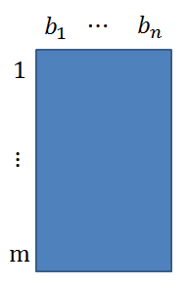
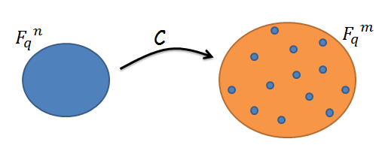
HSG for d=1 from Linear Codes
D: sample $r\sim \left[m\right]$ and output $\left({\left(b_{1}\right)}_{r},…,{\left(b_{n}\right)}_{r}\right)$.
Given $f\left(x_{1},…, x_{n}\right)=α_{1}x_{1}+⋯+α_{n}x_{n}$
$$f\left(D\right)=α_{1}{\left(b_{1}\right)}_{r}+⋯+α_{n}{\left(b_{n}\right)}_{r}$$
$$={\left(α_{1}b_{1}+⋯+α_{n}b_{n}\right)}_{r}$$
$$\operatorname{Pr}\left[f\left(D\right)=0\right]≤1−δ \sim ρ$$

Slide 13
Where does the Idea Break for d>1
D: sample $r\sim \left[m\right]$ and output $\left({\left(b_{1}\right)}_{r},…,{\left(b_{n}\right)}_{r}\right)$.
Given $f\left(x_{1},…, x_{n}\right)=α_{1}x_{1}+⋯+α_{n}x_{n}$
$$f\left(D\right)=α_{1}{\left(b_{1}\right)}_{r}+⋯+α_{n}{\left(b_{n}\right)}_{r}$$
$$={\left(α_{1}b_{1}+⋯+α_{n}b_{n}\right)}_{r}$$
$$\operatorname{Pr}\left[f\left(D\right)=0\right]≤1−δ \sim ρ$$

Slide 14
Where does the Idea Break for d>1
D: sample $r\sim \left[m\right]$ and output $\left({\left(b_{1}\right)}_{r},…,{\left(b_{n}\right)}_{r}\right)$.
Given $f\left(x_{1},…, x_{n}\right)=α_{1}{x_{1}^{}}^{3}x_{2}+⋯$
$$f\left(D\right)=α_{1}⋅{{\left(b_{1}\right)}_{r}^{}}^{3}{⋅\left(b_{2}\right)}_{r}+⋯$$
What is the meaning of multiplying codewords ?

Slide 15
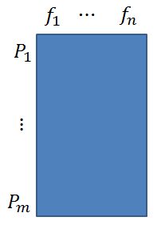
Evaluation Codes
Treat message as a function and evaluate it on wisely chosen places.
Example: [ReedSolomon60].
Fix distinct $P_{1},…,P_{m}∈F_{q}$ and set $f_{i}=x^{i−1}$
Given $t=\left(t_{0},…,t_{n−1}\right)∈{F_{q}^{}}^{n}$
Let $\hat{t}\left(x\right)=t_{0}+t_{1}x+⋯+t_{n−1}x^{n−1}$
$$C\left(t\right)=\left(\hat{t}\left(P_{1}\right),…,\hat{t}\left(P_{m}\right)\right)$$
Linear, and achieves the Singleton Bound over large fields ($q≥m$).

Slide 16
Evaluation Codes
Treat message as a function and evaluate it on wisely chosen places.
Reed-Solomon – univariate polynomials.
Reed-Muller – multivariate bounded degree polynomials.
AG codes [Goppa81] – polynomials will only get you so far…

Slide 17
Talk Outline
* PRGs.
* PRGs for low degree polynomials.
* Constructing a PRG for degree d=1 via linear codes.
* Where does the idea break for d>1 ?
* Algebraic Geometry codes to the rescue !
* Very high level idea of what AG codes are.
* Proof idea.

Slide 18
AG Codes [Goppa81]
Theorem [Goppa81]. There is a general way of constructing a linear valuation code from any algebraic function field.
The distance and rate are determined by the genus of the function field.
$$F_{q}\left(x,y\right)$$
$$y^{2}+y=x$$
$$F_{q}\left(x\right)$$

Slide 19
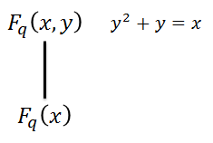
AG Codes [Goppa81]
Reed Solomon
AG Codes
Functions are spanned by $\left\{1,x,…,x^{n−1}\right\}$.
Rational functions in $x,y$ from an appropriate vector space (the Riemann-Roch space).
$m$ arbitrarily chosen evaluation points from $F_{q}$.
$m$ carefully chosen evaluation points from $F_{q}×F_{q}$.
Degree
Valuation
$$\deg\left(f⋅g\right)=\deg{f}+\deg{g}$$
$$v\left(f⋅g\right)=v\left(f\right)+v\left(g\right)$$
Distinct degrees implies linear independence.
Distinct valuations implies linear independence.

Slide 20
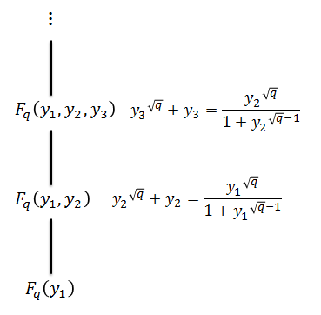
The Garcia-Stichtenoth Tower
Theorem [GarciaStichtenoth96].
$ρ+δ≥1−\frac{2}{\sqrt{q}−1}$
Exponential improvement over the probabilistic construction [GilbertVarshamov57].
Recall Plotkin bound: $ρ+δ≤1−\frac{δ}{q−1}+o\left(1\right)$.
Best one can do with AG codes [DrinfeldVladut83].

Slide 21
Talk Outline
* PRGs.
* PRGs for low degree polynomials.
* Constructing a PRG for degree d=1 via linear codes.
* Where does the idea break for d>1.
* Algebraic Geometry codes to the rescue.
* Very high level idea of what AG codes are.
* Proof idea.

Slide 22
HSG from AG Codes
D: sample a “valid” place P and output $\left(f_{1}\left(P\right),…, f_{n}\left(P\right)\right)$.
Given $f\left(x_{1},…, x_{n}\right)={x_{1}^{}}^{3}{x_{2}^{}}^{4}x_{3}+⋯$
$$f\left(D\right)=f_{1}{\left(P\right)}^{3}f_{2}{\left(P\right)}^{4}f_{3}\left(P\right)+⋯$$
$$=\left({f_{1}^{}}^{3}{f_{2}^{}}^{4}f_{3}\right)\left(P\right)+⋯$$
$$v\left({f_{1}^{}}^{3}{f_{2}^{}}^{4}f_{3}\right)=3v_{1}+4v_{2}+v_{3}$$
Each monomial induces a linear combination of the $v_{i}$’s.
We want these combinations to be pairwise distinct so to avoid cancelations.
Choosing the $v_{i}$’s (and corresponding $f_{i}$’s) at random will do. Now – derandomize (requires fairly standard ideas).

Slide 23
HSG from AG Codes
Main Result. There exists a HSG for degree d polynomials over fields of size $d^{2}$, that uses $d⋅\log{n}$ random bits. In fact, a random sub-code, with a proper dimension, of any good AG code will do.
Slightly weaker than [GX13], which require field size $d$. On the positive side, a straightforward, mathematically cleaner construction.
Running time is polynomial in the number of monomials (worst case, $n^{d}$).
Better understanding of the computational aspect of algebraic function field may lead to running-time logarithmic in the number of monomials.

Slide 24
Open Problems
* Obtain a PRG with optimal seed length. Perhaps by bypassing Bogdanov’s reduction.
* Strongly explicit constructions of Riemann-Roch spaces.
* Other applications of our method.
* Break the log(n) barrier for constant size fields.
* Applications of PRG for low degree polynomials.

Slide 25
Thank you for your attention !

